Slide 1
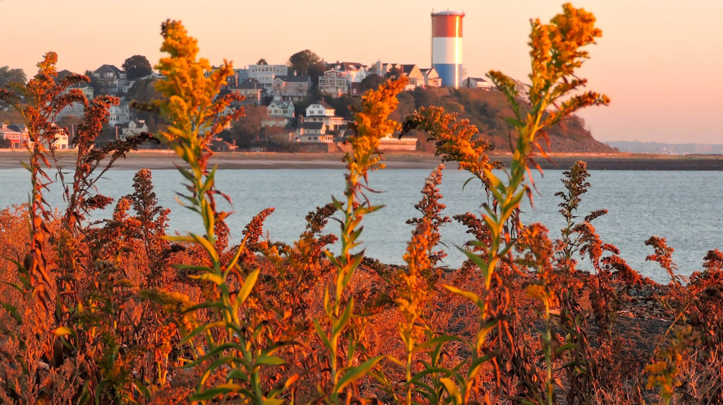
Town of Winthrop 2024 Fall Forum
October 15, 2024

Slide 2

Town of Winthrop 2024
Fall Forum
Town of Winthrop Updates Town Manager Tony Marino
Council on Aging COA Director Matt Rodes
Winthrop Public Library Library Director Greg McClay
Winthrop Veterans Services Veterans Service Officer Phil Ronan

Slide 4
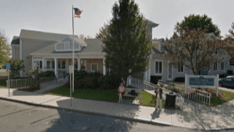
Winthrop Council on Aging

Slide 5

Winthrop Council on Aging
Mission Statement
The Council on Aging will encourage and promote, through activities, programs, and services, independence to enhance the quality of life, and the dignity of all seniors who live within the community

Slide 6

Programming and Services
Registered over 15,000 visits to the Senior Center
Provided over 4,000 “grab-and-go” lunches and 600 dine-in lunches at the Senior Center
Meals on Wheels delivered over 40,000 meals to Winthrop residents
Provided approximately 2,500 door-to-door rides through the Van Transportation Program
Over 550 people participated in day and over-night trips sponsored by the Senior Center

Slide 7
Council on Aging Goals
Boost ridership and raise awareness of the Van Transportation Program through targeted outreach and community engagement initiatives
Expand recruitment efforts to attract additional volunteers for the Friendly Visitor Program and Medical Escort Program
Enhance collaboration with WPD and the Suffolk County DA’s Office to deliver comprehensive fraud and scam awareness programs at the Senior Center
Explore opportunities to incorporate intergenerational programming into our activity schedule, fostering connections between different age groups

Slide 8

Winthrop Public Library

Slide 9
Physical and Digital Content

Slide 10
LIBBY
LIBBY LIBBY LIBBY LIBBY LIBBY LIBBY LIBBY LIBBY LIBBY LIBBY LIBBY LIBBY LIBBY LIBBY LIBBY LIBBY LIBBY LIBBY LIBBY LIBBY LIBBY LIBBY LIBBY LIBBY LIBBY LIBBY LIBBY LIBBY LIBBY LIBBY LIBBY LIBBY LIBBY LIBBY LIBBY LIBBY LIBBY LIBBY LIBBY LIBBY LIBBY LIBBY LIBBY LIBBY LIBBY LIBBY LIBBY LIBBY LIBBY LIBBY LIBBY LIBBY LIBBY LIBBY LIBBY LIBBY LIBBY LIBBY LIBBY LIBBY LIBBY LIBBY LIBBY LIBBY LIBBY LIBBY LIBBY LIBBY LIBBY LIBBY LIBBY LIBBY LIBBY LIBBY LIBBY LIBBY LIBBY LIBBY LIBBY LIBBY LIBBY LIBBY LIBBY LIBBY LIBBY LIBBY LIBBY LIBBY LIBBY LIBBY LIBBY LIBBY LIBBY LIBBY LIBBY LIBBY LIBBY LIBBY LIBBY LIBBY LIBBY LIBBY LIBBY LIBBY LIBBY LIBBY LIBBY LIBBY LIBBY LIBBY LIBBY LIBBY LIBBY LIBBY LIBBY LIBBY LIBBY LIBBY LIBBY LIBBY LIBBY LIBBY LIBBY LIBBY LIBBY LIBBY LIBBY LIBBY LIBBY LIBBY LIBBY LIBBY LIBBY LIBBY LIBBY LIBBY LIBBY LIBBY LIBBY LIBBY LIBBY LIBBY LIBBY LIBBY LIBBY LIBBY LIBBY LIBBY LIBBY LIBBY LIBBY LIBBY LIBBY LIBBY LIBBY LIBBY LIBBY LIBBY LIBBY LIBBY LIBBY LIBBY LIBBY LIBBY LIBBY LIBBY LIBBY LIBBY LIBBY LIBBY LIBBY LIBBY LIBBY LIBBY LIBBY LIBBY LIBBY LIBBY LIBBY LIBBY LIBBY LIBBY LIBBY LIBBY LIBBY LIBBY LIBBY LIBBY LIBBY LIBBY LIBBY LIBBY LIBBY LIBBY LIBBY LIBBY LIBBY LIBBY LIBBY LIBBY LIBBY LIBBY LIBBY LIBBY LIBBY LIBBY LIBBY LIBBY LIBBY LIBBY LIBBY LIBBY LIBBY LIBBY LIBBY LIBBY LIBBY LIBBY LIBBY LIBBY LIBBY LIBBY LIBBY LIBBY

Slide 11












Business & Technology
Over 90,000 Titles

Slide 12






Streaming Video
Add app to Roku, Fire Stick, etc.
Access from the web from anywhere
Over 3,000 movies, tv programs & documentaries

Slide 13



Adult Programming

Slide 14





Slide 15





Slide 16


Slide 17

Town of Winthrop Veterans Services

Slide 18
Winthrop Veteran Services
Provide Chapter 115 Assistance for low-income veterans.
Assist with VA healthcare.
Help Winthrop veterans navigate and submit VA compensation claims and applications.
Work with our veterans to acquire housing, seek employment opportunities, aid in food insecurity and provide community outreach and crisis intervention.

Slide 19
2024 Dedications
New flagpole at Veterans field (WHS Baseball field)
Dedication of street corner memorials for the following:
Capt. Donald Sullivan
CPL. Ronald “Lou” Camacho
PFC. Robert Sheppard
Police Station Dedication of CPL. Channing MacDonald
Replaced multiple street corner memorials which were beyond repair
Installed flags on all street corner memorials in lieu of Memorial Day
Petitioned the Town Council to sign a proclamation declaring Winthrop a Purple Heart town
This Veterans Day we will be dedicating the Women’s Veterans Memorial
As Chairman of the Memorial Committee oversaw the dedication of the Covid Tree memorial at Town Hall and the dedication of the John Domenico tennis courts.

Slide 20

Winthrop Department of Veterans’ Services
Ground Floor
E.B Newton Cultural Center
Winthrop, MA 02152
Office Hours
Monday through Thursday 7:00 AM - 3:00 PM
Appointments are available.
Phone: (617) 846-3065
Fax: (617) 846-0161
E-Mail: pronan@winthropma.gov

