Slide 1
Winthrop
Community Electricity
December 2, 2024

Slide 2
Offer new electricity supply options that provide more renewable energy and stable prices for all Winthrop residents and businesses.
Although savings cannot be guaranteed, these programs have historically provided savings compare to utility Basic Service over the contract term.
Purpose

Slide 3
Winthrop chose Direct Energy as its electricity supplier, and will offer three supply options.
Program starts January 2025 and prices are fixed for 35 months.
Our Electricity Supplier

Slide 4
Participation in Winthrop Community Electricity will only change the “Supply” portion of your National Grid electricity bill.
What
Changes

Slide 5
The “Delivery” portion of your National Grid bill will remain the same.
National Grid will still continue to deliver electricity, maintain poles and wires, and respond to storm outages
You will still pay just one bill to National Grid
Anyone using budget billing or receiving low-income rate discounts will continue to receive their current benefits.
Customers receiving net metering or other solar benefits will continue to receive their current benefits.
What Stays the Same

Slide 6
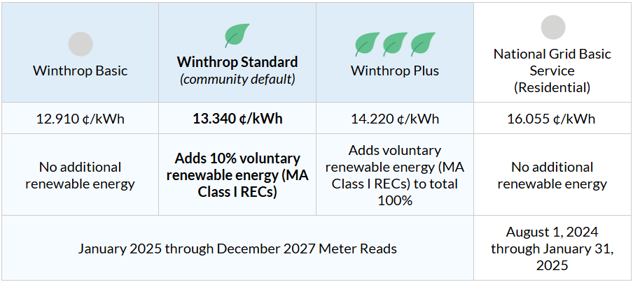
Our Program Options
Future savings compared to utility Basic Service cannot be guaranteed.

Slide 7
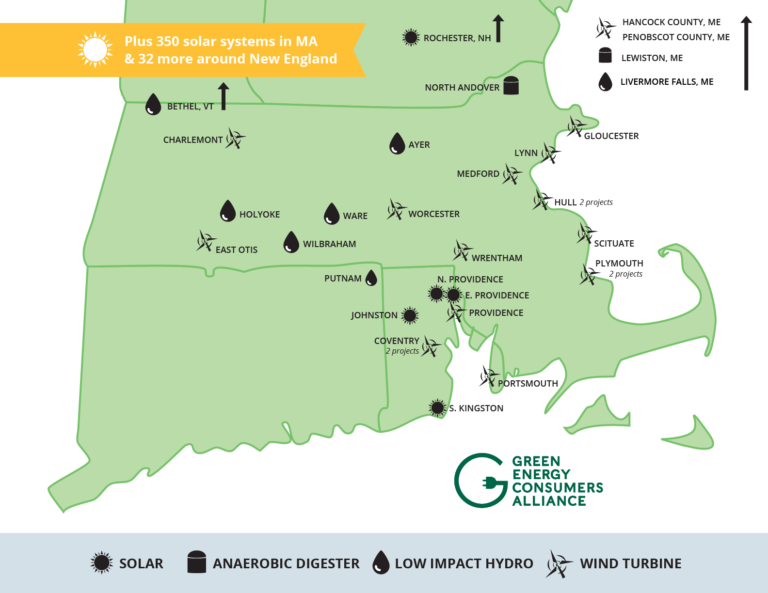
Our Voluntary Renewables
Come only from Class I sources, the State’s term for new, in-region renewables
From wind, solar, low-impact hydro and anaerobic digestion in New England
Class I preferred by MA Dept. of Energy Resources because it supports the growth of additional renewables

Slide 8
Participation & Enrollment
Participation is voluntary.
There is never any penalty or fee to opt out of the program.
The enrollment process differs based on your current electricity supplier.

Slide 9
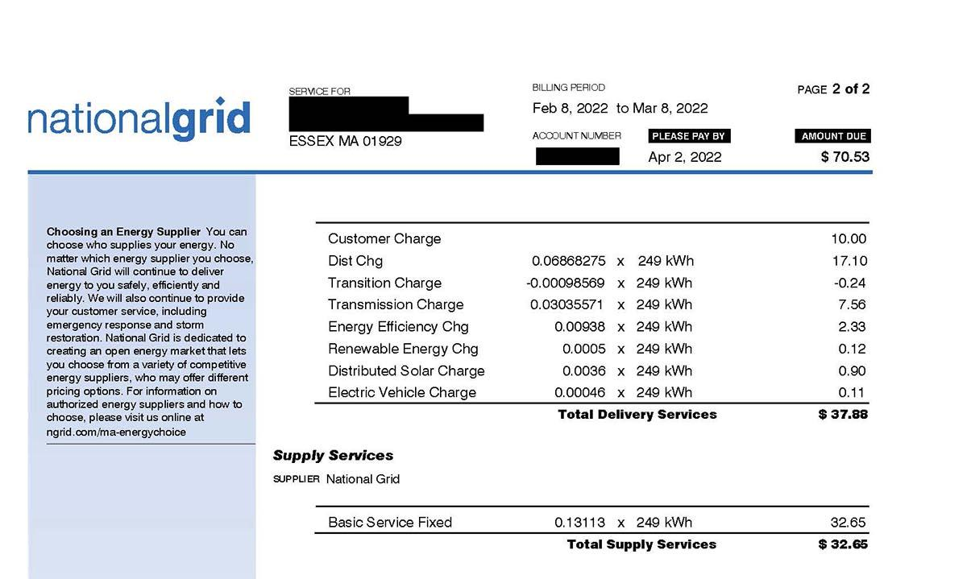
How To Find Your Current Supplier
If your electricity supplier says National Grid, then you are using Basic Service.

Slide 10
Customers on Basic Service
(1 of 3)
Anyone using National Grid Basic Service is eligible to be automatically enrolled in the Winthrop Standard as of their January meter read.
These customers received a notification letter in Mid-November, explaining their options.
If an eligible customer takes no action, they will be enrolled in Winthrop Standard starting in January.

Slide 11
Customers on Basic Service
(2 of 3)
If eligible for automatic enrollment:
Dec 14: deadline to opt-out before the program starts.
You may opt-out at any time after Dec 14, and you will be returned to National Grid Basic Service supply on your next meter read.
There is never any penalty or fee to opt out of the program.

Slide 12
Customers on Basic Service
(3 of 3)
To Choose a different Winthrop option:
Fill out the online form at WinthropCommunityElectricity.com OR call our supplier, Direct Energy, at (866) 968-8065
To Opt Out of the Winthrop Program:
Return the postage paid card in your notification letter OR fill out the online form at WinthropCommunityElectricity.com OR call our supplier, Direct Energy, at (866) 968-8065

Slide 13
Customers Using Their Own Supplier
Anyone currently using their own supplier will not receive the notification letter and will not be automatically enrolled.
These customers can voluntarily join the program, but should check with their current supplier in case their current supplier charges penalties or early termination fees.

Slide 14
Our Pre-Launch Awareness
In addition to the notification letter, we have spread the word through:
Press release
Online news blurb
Hard copy FAQs at Town Hall
Postcard sent to all eligible customers

Slide 15
Questions
& Support
To opt-out, change your option or proactively enroll:
Call Direct Energy at (866) 968-8065
Fill out the enroll or opt-out form at WinthropCommunityElectricity.com
For questions, contact Winthrop’s consultant, Good Energy:
Call (617) 329-5783
Fill out the contact form at WinthropCommunityElectricity.com
Reminder: you may change your option or opt-out of the program at any time

