Slide 1

TOWN OF WINTHROP
  DRAFT BUDGET PRESENTATION
  FINANCE COMMISSION
  APRIL 10, 2025

Slide 2

Estimated 2026 Levy

Slide 3
Estimated 2026 Revenues

Slide 4
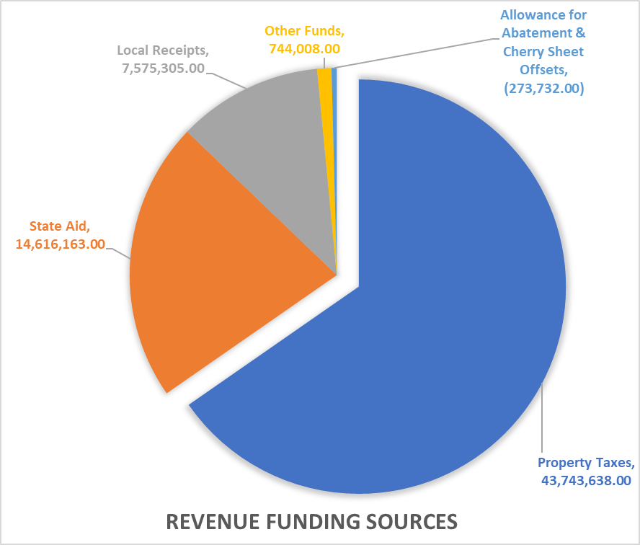
Total Estimated 2025 Revenues

Slide 5
2026 BASE BUDGET

Slide 6
FY26 Base budget continued

Slide 7
FY26 Base budget continued

Slide 8
General Fund Town appropriations

Slide 9
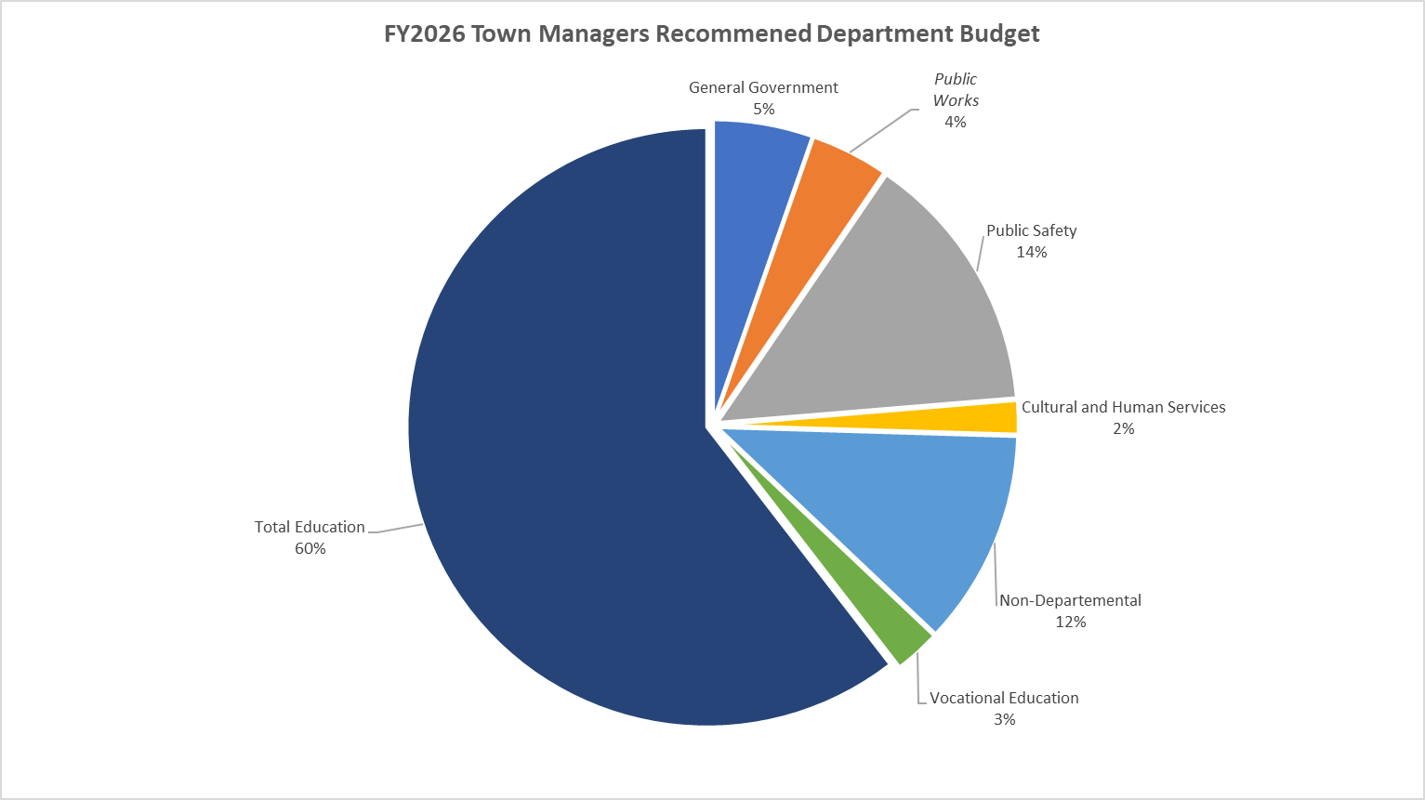
FY2026 town Appropriations

Slide 10

questions

