Slide 1
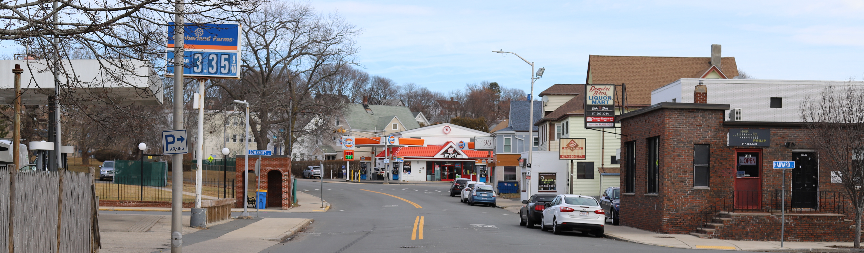




Winthrop – Revere Street Project
Construction Update
Public Information Meeting
April 12, 2025

Slide 2



Agenda
Welcome and Introductions
Project Team
Proposed Improvements
Construction Progress to Date
Construction Schedule
Work Hours
Traffic Impacts
Questions & Answers

Slide 3

Project Team
Town of Winthrop
Proponent of the Project
Responsible for funding design, permitting, and right-of-way acquisition
MassDOT’s Highway Division
Responsible for administering design process, funding construction, and providing Resident Engineer services
CHA Consulting, Inc.
Responsible for design
A.R. Belli, Inc.
Responsible for construction

Slide 4
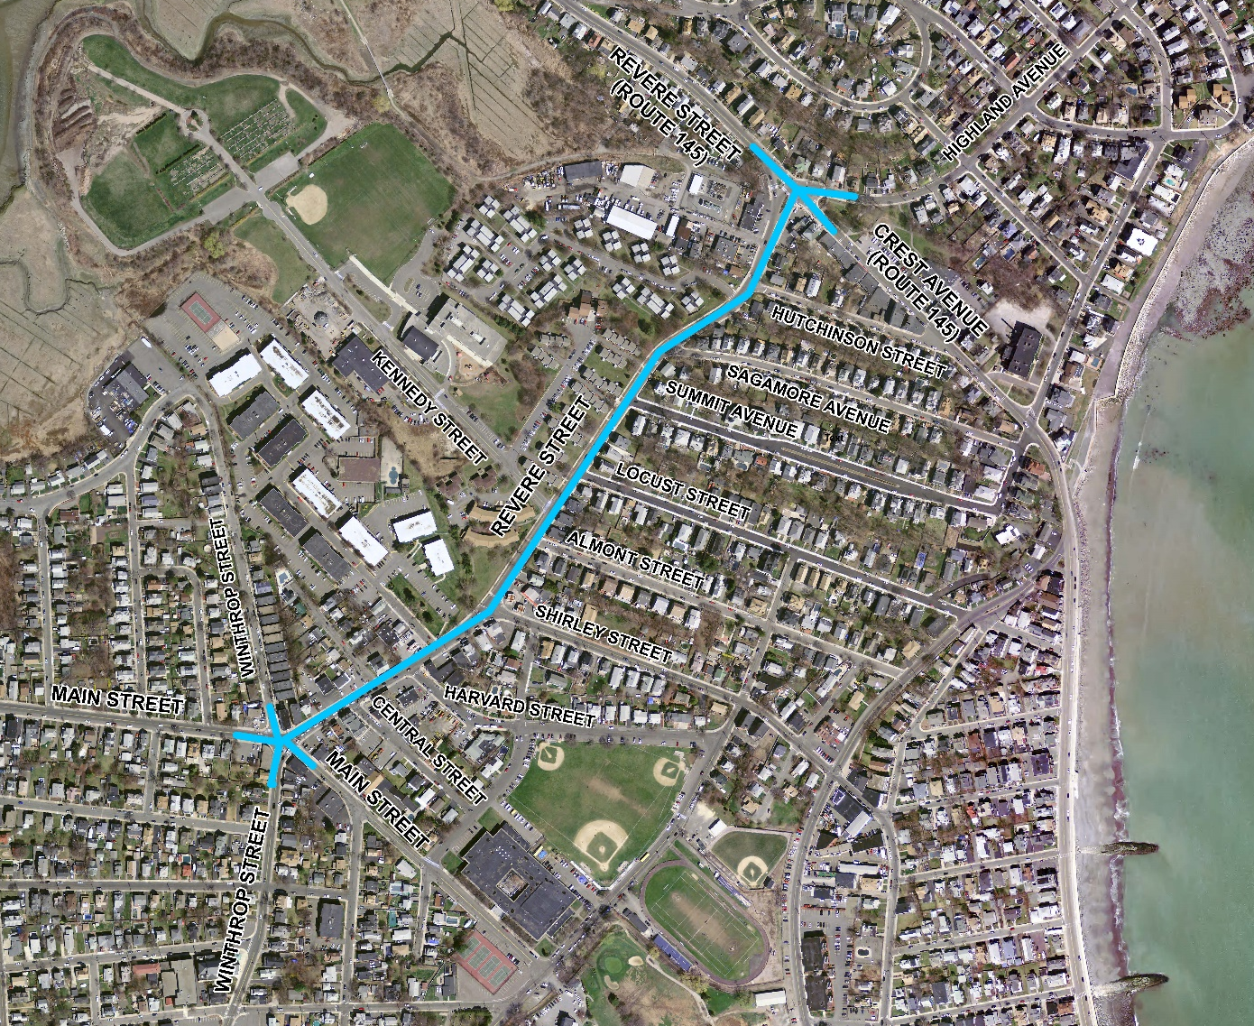

Project Area
Key Facts
0.6 mile length
16,000 vehicles per day
Contract Value: $7.5 million

Slide 5
Project Improvements
Infrastructure Upgrades
Pavement:
Reconstruct existing pavement and sidewalks
Traffic Signals:
Replace all traffic signal equipment at Magee’s Corner and at Crest Avenue intersection.
Drainage:
Replace old clay drainage system with new concrete/ ductile iron pipes and new catch basins
Regrade roadway to reduce flooding & ponding
Lighting:
Replace light poles with new decorative light poles
Utilities:
National Grid to replace old gas main

Slide 6
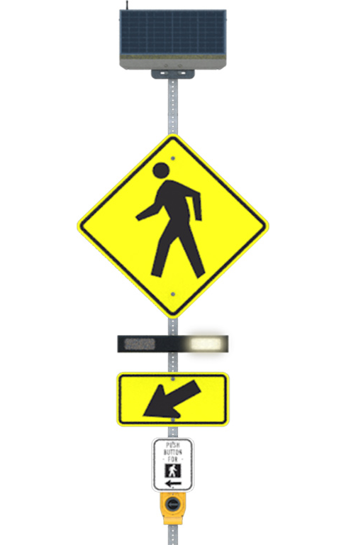
Project Improvements (cont’d)
Pedestrians
Reconstruct sidewalks and curb ramps for Americans with Disability Act (ADA) compliance
Traffic signal equipment upgrades for pedestrian accessibility
Add Rectangular Rapid Flashing Beacons (RRFB) at crosswalks
New crosswalks:
Across Shirley Street at intersection with Revere Street
Across Revere Street at intersection with Locust Street
Bicycles
Stripe 5’ wide bike lanes
Northern side of road between Main Street and Shirley Street
Maintain on-street parking on south side of road
Both sides of road between Shirley Street and Crest Avenue
RRFB Example

Slide 7
Project Improvements (cont’d)
Public Bus Transit
Relocate bus stops based on coordination with the MBTA
Generally, move bus stops to the far side at intersections for improved operations
Widen sidewalks at bus stops
Equip traffic signals with Transit Priority Relays to reduce bus delays at signals
Vehicles
Reduce congestion at Kennedy Drive during school pick-up/ drop-off hours
Widen roadway to provide “pull-off” area for vehicles queued on Revere Street

Slide 8
Construction Progress to date
Underground work 95% complete
Drainage system completely reconstructed
Gas main replaced
Conduit installed for new traffic signals
Other minor utility relocations

Slide 9
Construction Schedule
Spring – Summer – Fall '25
Roadway, traffic signal and sidewalk reconstruction (Main to Kennedy)
MORE DETAILED INFO NEEDED FOR 2025 CONSTRUCTION
Summer '26 – Fall '26
Roadway, traffic signal and sidewalk reconstruction (Kennedy to Crest)

Slide 10
Work Hours
Typical Work Shift
Mondays through Fridays
7:00 AM to 3:30 PM each day
Work requiring lane closures shall not be carried out during peak traffic hours of 6:00 AM to 9:00 AM and 3:00 PM to 7:00 PM.
No lane closures near Kennedy Drive during school pick-up/ drop-off hours

Slide 11
Traffic Impacts
Maintain at least one lane of travel on Revere Street throughout construction. Two-way traffic will be maintained at all times using alternating flow.
Police details will be utilized to maintain safe travel for the public during construction
One lane of traffic will generally be impacted daily

Slide 12
Points of Contact
Town of Winthrop Department of Public Works
Director, Steven Calla
617-846-1341
MassDOT
Resident Engineer, Tibebu Gashaw
tibebu.gashaw@dot.state.ma.us
Visit the Town website for biweekly updates of construction progress and upcoming work

