Slide 1
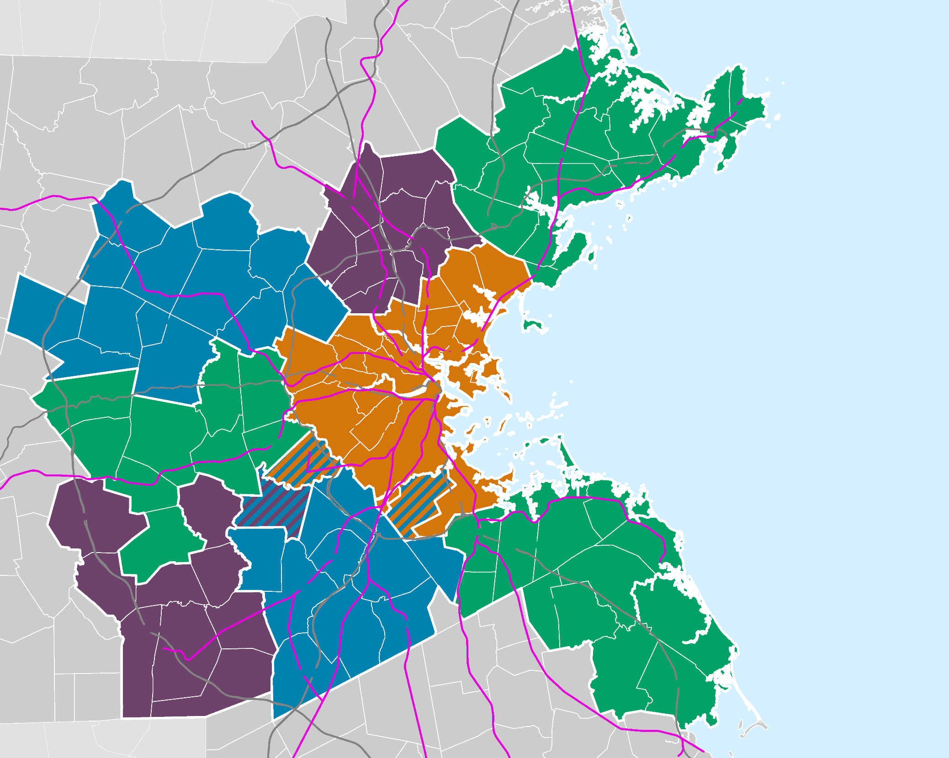


Winthrop Hazard Mitigation Plan 2025 Update
Public Meeting #1
May 20, 2025 Winthrop Town Council
Martin Pillsbury
Metropolitan Area Planning Council

Slide 2
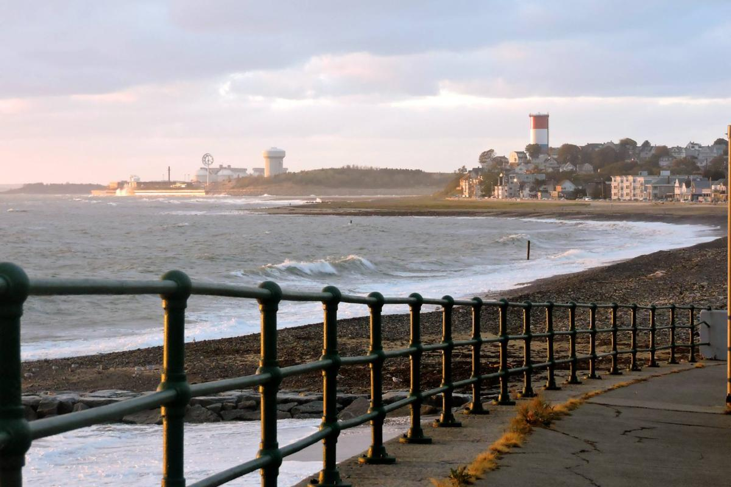
Background: Hazard Mitigation

Slide 3


Overview of Hazard Mitigation Planning
Why is Winthrop doing this plan?
Disaster Mitigation Act of 2000: FEMA National Hazard Mitigation Guidelines
Periodic Plan Updates: Updated data and priorities
FEMA grant eligibility: Approved Plan required for FEMA Mitigation Grants
Notes:
The Federal Disaster Mitigation Act of 2000 requires communities to adopt a Hazard Mitigation Plan to be eligible for FEMA mitigation grants.​
This Plan update will meet FEMA’s requirements and make the town eligible for FEMA mitigation project grants​
Take advantage of available FEMA funding (BRIC & FMA grants)​
​
This is not an emergency response plan​
​

Slide 4








Overview of Hazard Mitigation Planning
Reducing impacts of natural hazards through strategies including projects, programs, and policies.
A plan for Multiple Natural Hazards
Flooding (coastal and inland)
Wind events (thunderstorms, hurricanes, tornadoes)
Winter hazards (blizzards, nor’easters)
Geologic hazards (earthquakes, landslides)
Wild Fires
Extreme temperatures and drought
What preventative actions are being taken now to reduce risks and damages?
What additional actions can be taken in the future to increase resilience?
Notes:
The Federal Disaster Mitigation Act of 2000 requires communities to adopt a Hazard Mitigation Plan to be eligible for FEMA mitigation grants.​
This Plan update will meet FEMA’s requirements and make the town eligible for FEMA mitigation project grants​
Take advantage of available FEMA funding (BRIC & FMA grants)​
​
This is not an emergency response plan​
​

Slide 5

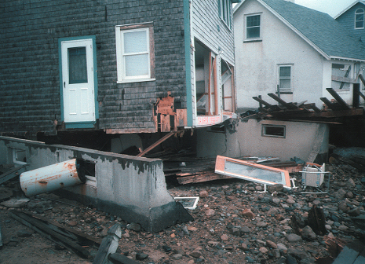
Breaking the Cycle of Disaster & Rebuilding
Rebuild
Disaster
Disaster
Rebuild

Slide 6
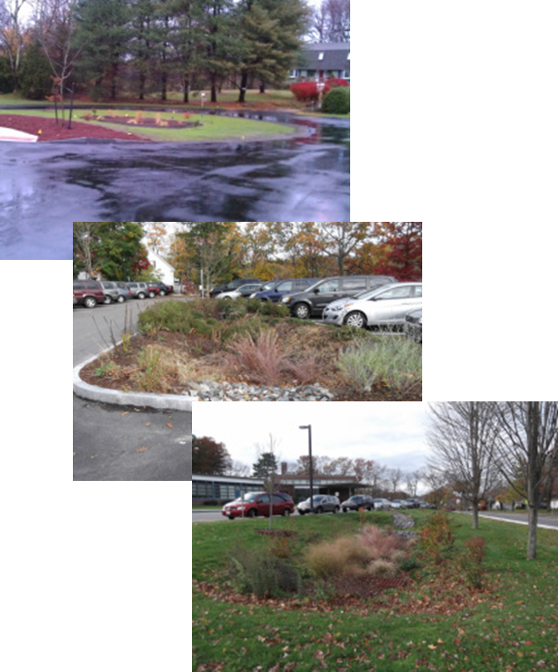
Techniques for Hazard Mitigation
Prevention
Property Protection
Public Education and Outreach
Protect Natural Resources
Structural Projects (culverts, pumps, dams)
Emergency Services Protection
Notes:
Hazard mitigation strategies to reduce specific risks can vary from very simple to complex. They are comprised of one or more hazard mitigation actions. There are so many different hazard mitigation actions that they are often classified into six categories

Slide 7

Hazards Mitigation and Climate Change
Natural Hazards: a source of harm created by an environmental or geological event, including flooding and earthquakes
Natural Hazard Mitigation: reducing damage from natural hazards, including short-term, episodic events
Climate Change: increases the frequency, duration, and intensity of natural hazards; including heat, drought, and precipitation
Climate Adaptation: reducing the risk to, and mitigating impacts from, the increasing frequency of natural hazards
Adapting to the expected impacts of climate change is a form of hazard mitigation

Slide 8
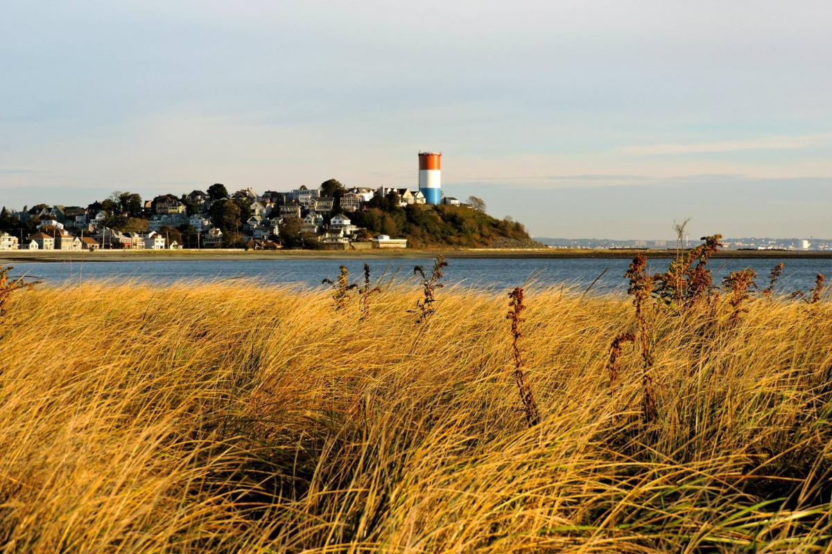
The Planning Process

Slide 9
Process Guided by the Local Hazard Mitigation Team
Local Team Role:
Update critical facilities and local hazard areas
Review mitigation goals
Provide local knowledge on existing mitigation measures
Review mitigation actions for the updated plan
Town Manager/Asst. TM
Fire Department
Police Department
Department of Public Works
Planning Board
Conservation Commission Board of Appeals
Building Commissioner
Public Health
Resilience Manager
Sustainability Manager

Slide 10

Plan Development Process
TEAM#1: Update & Map Critical Facilities
Assessment of Risks & Vulnerabilities
TEAM#2: Review Existing Mitigation
TEAM #3 Update Status of Mitigation
1st Public Meeting
TEAM #4 Review the Mitigation Strategy
Prepare Draft Plan
2nd Public Meeting Review Draft Plan
We are here!

Slide 11
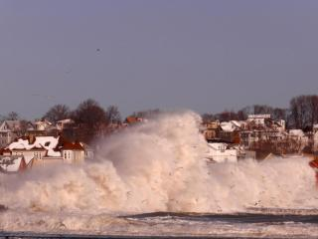
Hazards and Vulnerability

Slide 12
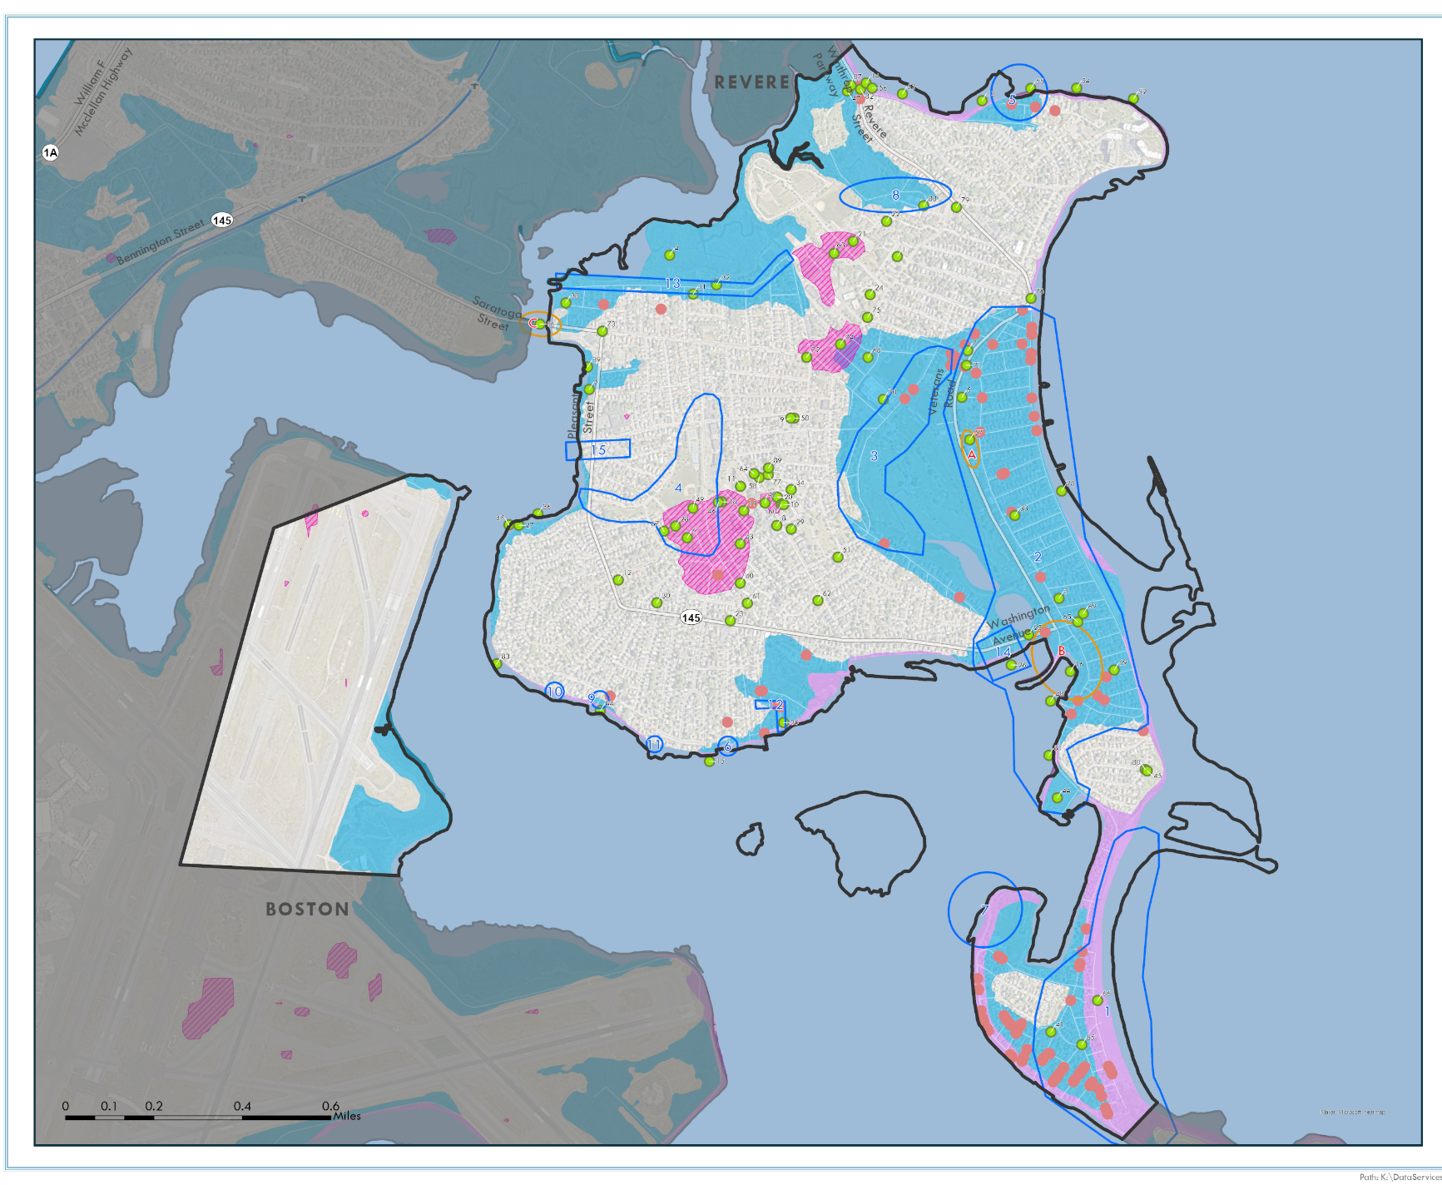
Winthrop: Local Flood Hazard Areas
Identified by the Local Team:
Yrillel Beach
Shirley Street Neighborhood
Lewis Lake
Somerset seawall & headwall
Cottage Park seawall & headwall
Sargent Street seawall & headwall
Woodside seawall & headwall
Coughlin Park
Bayou Street Neighborhood
Ingleside Park
Lower Nahant Avenue
Pico Avenue
Morton Street
Washington Avenue & River Road
Pleasant Street @ Girdlestone Rd.

Slide 13

Winthrop: Examples of 89 Critical Facility Sites
Identified by the Local Team:
Winthrop Police Dept
Winthrop Fire HQ
Winthrop DPW Building
Winthrop EOC Town Hall
Public Safety Communication Tower
Belle Isle Bridge
Lewis Lake Tidal Gate
Stone Revetment, Seawall
Pico Sewer Pump Station Winthrop Water Storage Tank
Deer Island Wastewater Facility
Pleasant Times Day Care
Arthur Cummings School
Children's Corner Preschool
Winthrop Senior Center

Slide 14
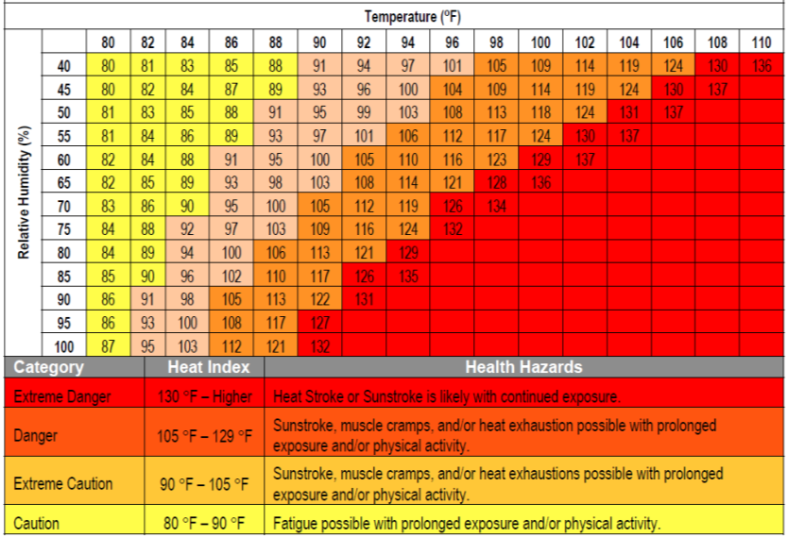
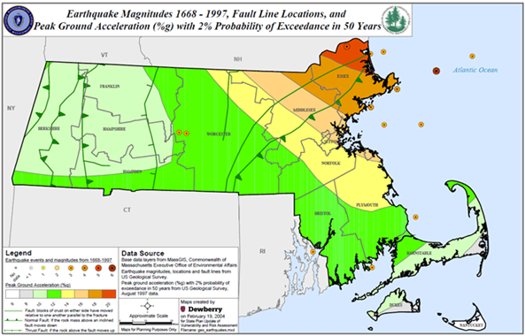
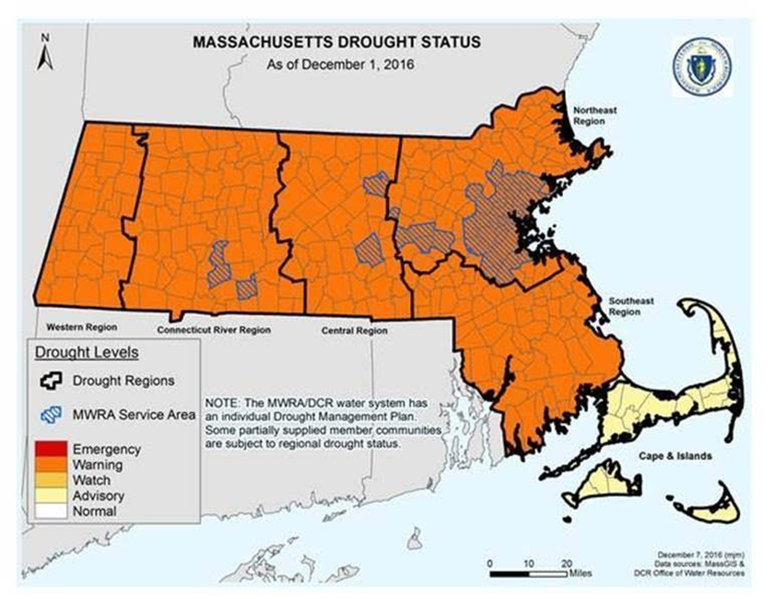
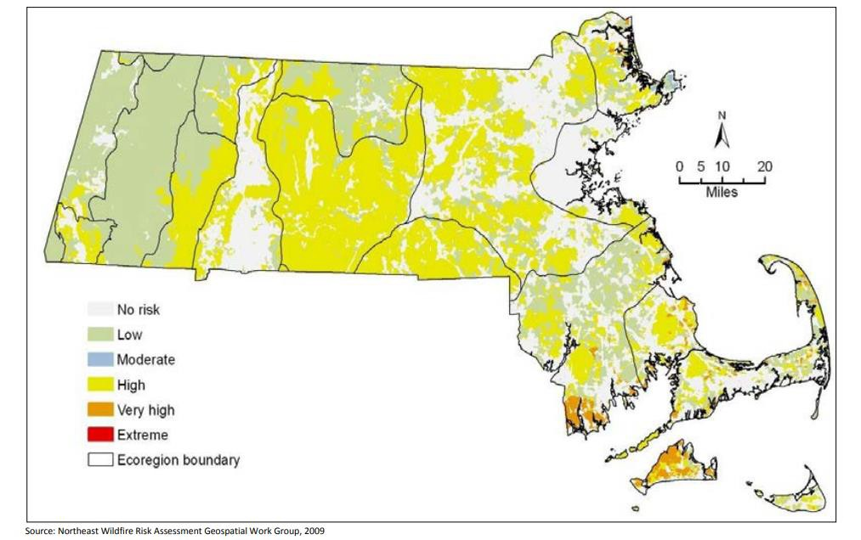
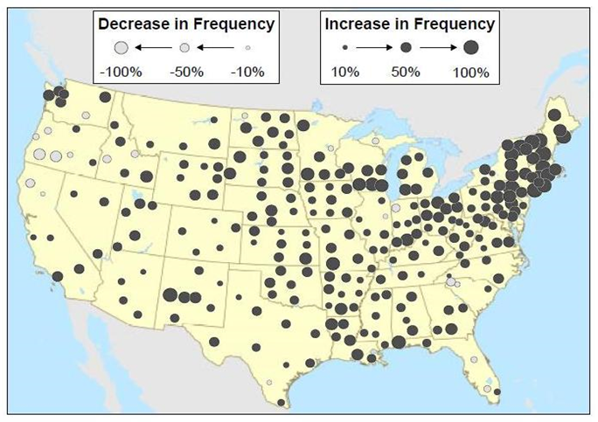
Other Natural Hazards
Extreme Heat
Earthquakes
Drought
Wildfires
Extreme Precipitation

Slide 15
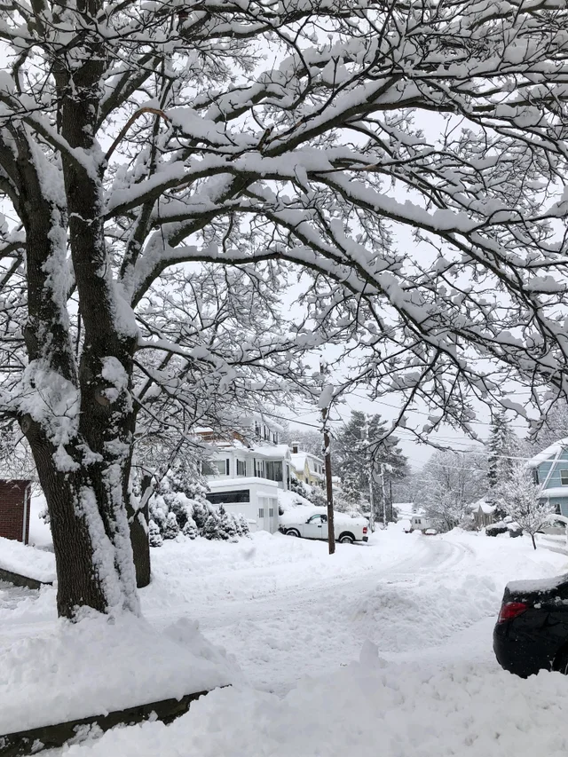
Wind & Winter Hazards: Nor’easters/Blizzards
Storm Event | Date
Superstorm Sandy | October/November 2012
Severe Winter Storm, Snowstorm, Flooding | February 2013
Severe Winter Storm, Snowstorm, Flooding | January 2015
Severe Winter Storm | March 2018
Severe Winter Storm, Blizzard | December 2020
Severe Winter Storm, Snowstorm, Flooding | February, April, October 2021
Notes:
Tropical Storm in 1908- Reading, avg. snowfall is 48 – 72 inches per year

Slide 16
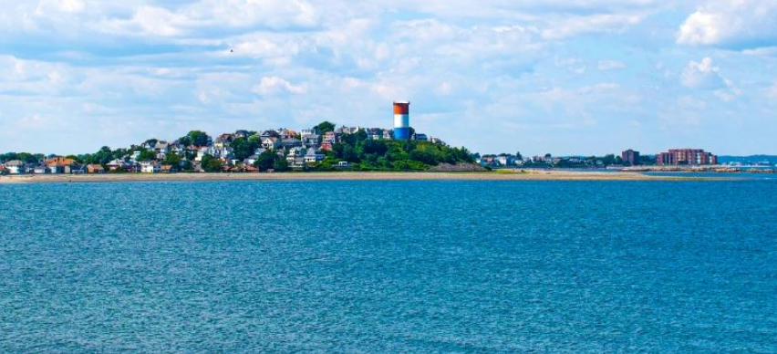
Mitigation Recommendations

Slide 17
Next steps: Update Mitigation Recommendations from the 2015 Plan
FLOODING HAZARDS
Yirrell Beach project
Complete utility elevation project in flood hazard area
Lewis Lake drainage
Ingleside Park
Lower Nahant Avenue
Boston Harbor Drainage Outfall Headwalls and Seawalls
Consider submitting a Community Rating System (CRS) application
Acquire/pre-serve vacant flood prone lands as they become available.
Upgrade Bayou Street drain line; consider closed pipe system
WIND HAZARDS
Work to ensure electrical utilities are properly maintained
WILDFIRE HAZARDS
Develop and maintain a wildfire database
DROUGHT HAZARDS
Incorporate drought tolerant species into land use regulations
Require permeable surfaces to promote infiltration and reduce runoff
MULTI HAZARDS
Upgrade emergency generators: Town Hall/EOC

Slide 18
Next Steps for Developing the Plan
Prepare the draft Hazard Mitigation Plan
2. 2nd Public Meeting – Present Draft Plan, seek public comments
3. Finalize Plan – submit the Draft Plan to MEMA & FEMA
4. Town Adoption of Final Plan – after FEMA approval of the Plan
The updated plan will be approved by FEMA for the next 5 years

Slide 19
Thank You!
Questions and Comments may be sent to:
Martin Pillsbury
MAPC Environmental Director
WinthropResilience@mapc.org

