Slide 1
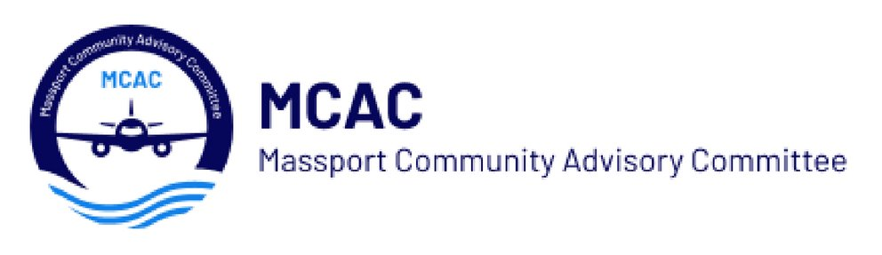
Massport Community Advisory committee established by legislation in 2014 35 communities represented; 41 representatives voice of impacted communities provide oversight to Massport rnav study made modifications to some flight patterns to reduce noise impact current focus on air quality, climate impacts advocacy residential soundproofing program Massport development projects – Mepa logan working group – air quality mitigation projects legislation
History of MCAC:

Slide 2
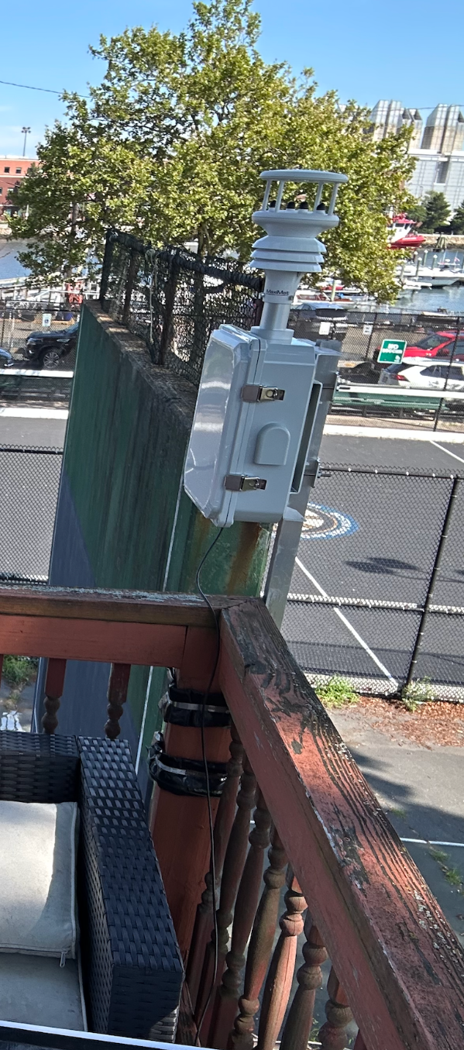
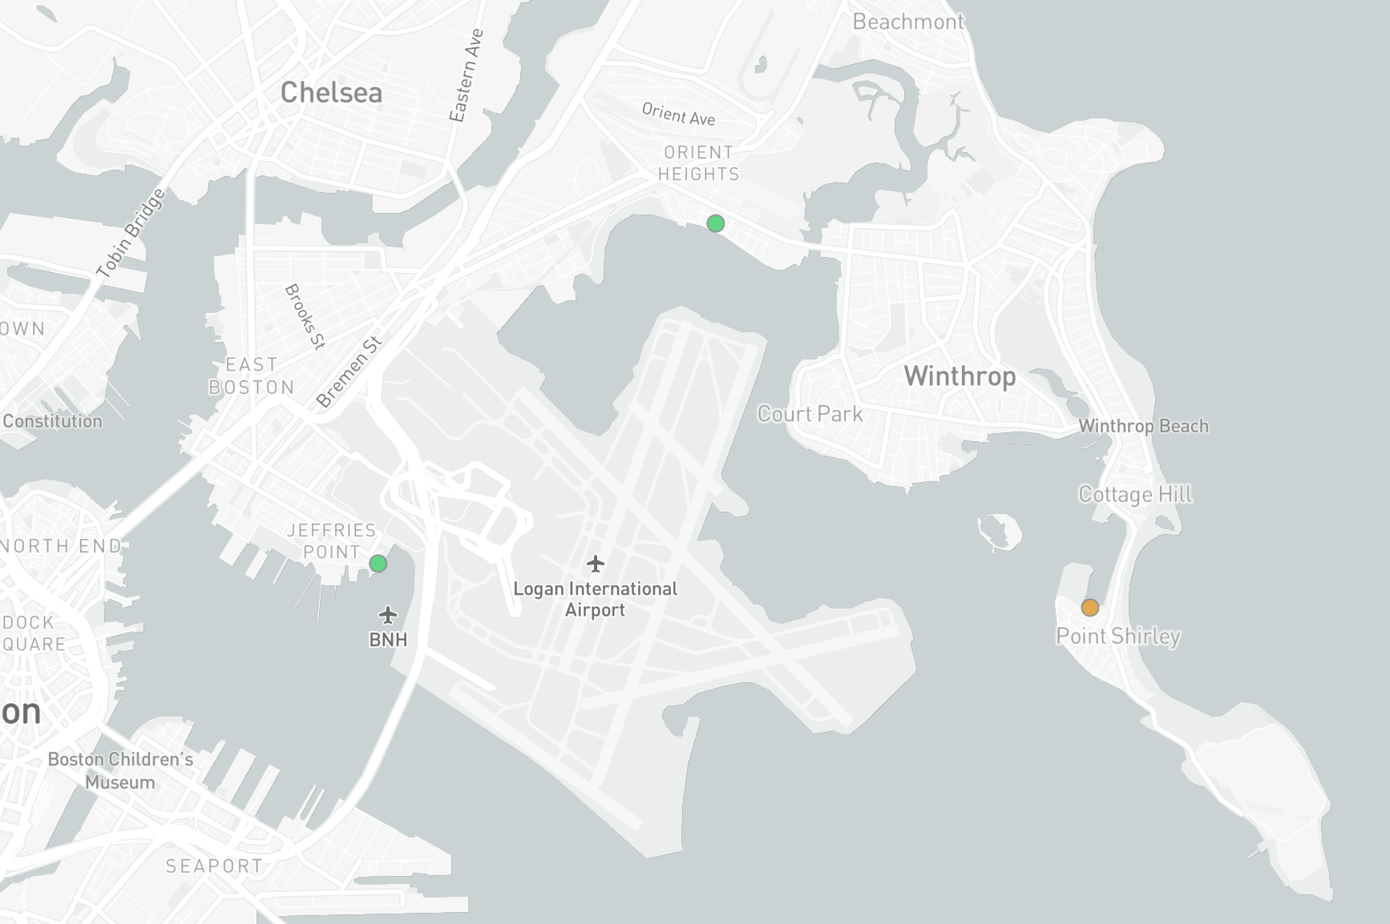
Logan Air Monitoring Program
One reference grade sensor in East Boston – collecting data since December 2024
Three QuantAQ Modulair UFP sensors – two in East Boston, one in Winthrop since August 2025

Slide 3
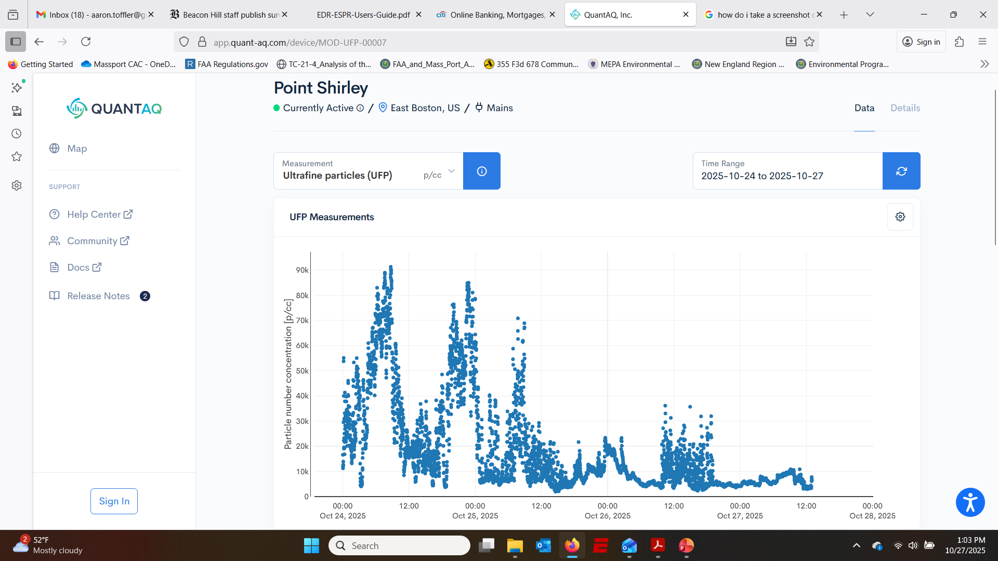
MCAC Website Resources
Emissions Calculator
Massport Board Meeting Notes
MCAC meeting schedules/Zoom links
Scientific research on Ultrafine Particulate matter

