Slide 1
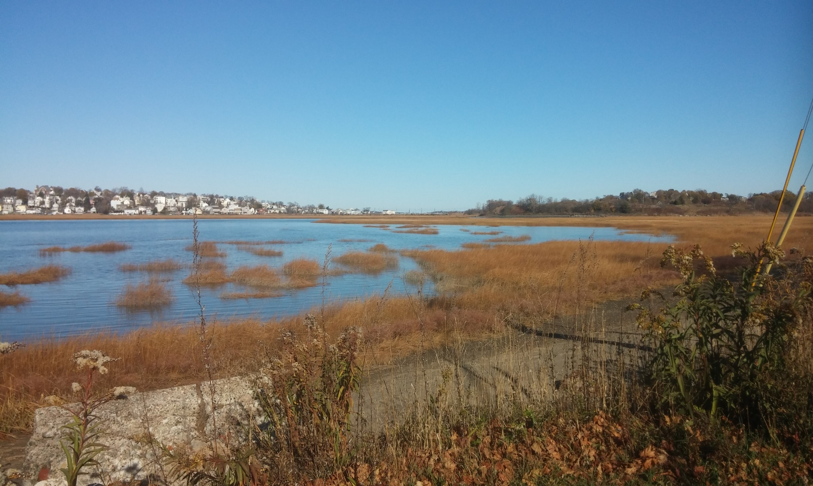
Belle Isle Marsh Marine Ecology Park in Winthrop
A vision for responsible stewardship and management of the natural resource at Belle Isle Marsh

Slide 2
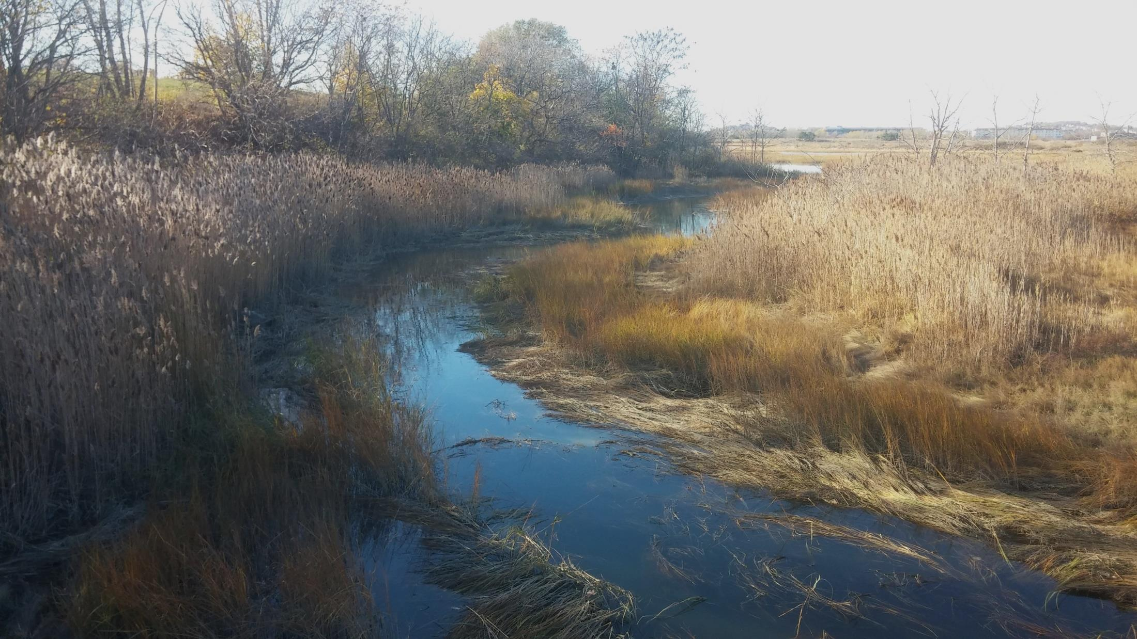
A Unique Resource – the only Massachusetts Great Salt Marsh in an urban setting - ACEC
Stewardship & Management – DCR set the tone with construction of the Kilmartin Walkway and Footpath at Short Beach 5 years ago
Next Step - Complete that vision by developing the Marine Ecology Park and Marsh Walk

Slide 3
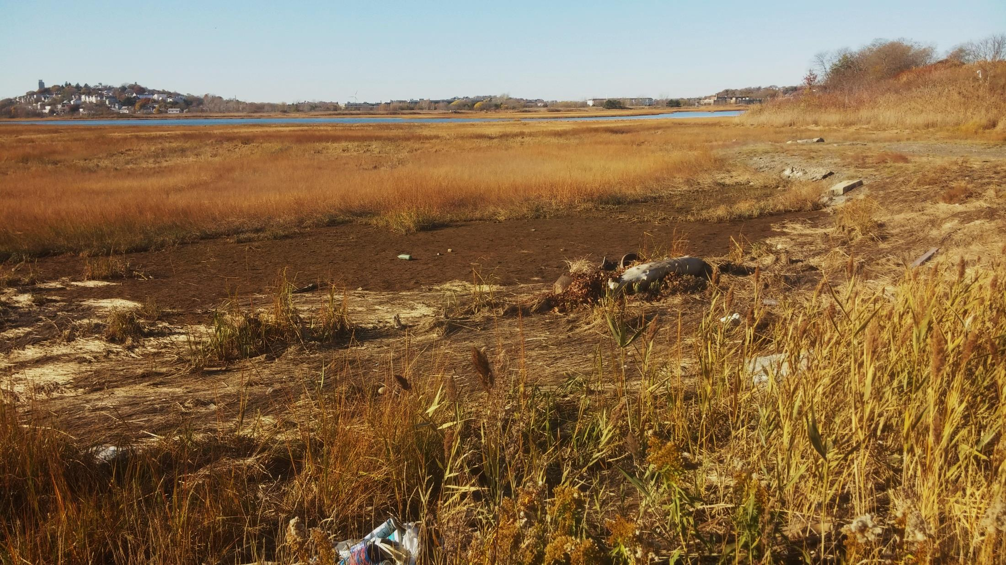
Transformational
In the absence of a sensitive means to connect people to this place, the Marsh has suffered
The Marine Ecology Park and Marsh Walk will provide the region with an outdoor laboratory that will bring students and visitors to learn about and enjoy a Great Salt Marsh in an urban setting
As an additional benefit the project will showcase complex ecology in an urban environment that is both sustainable and resilient to climate change

Slide 4
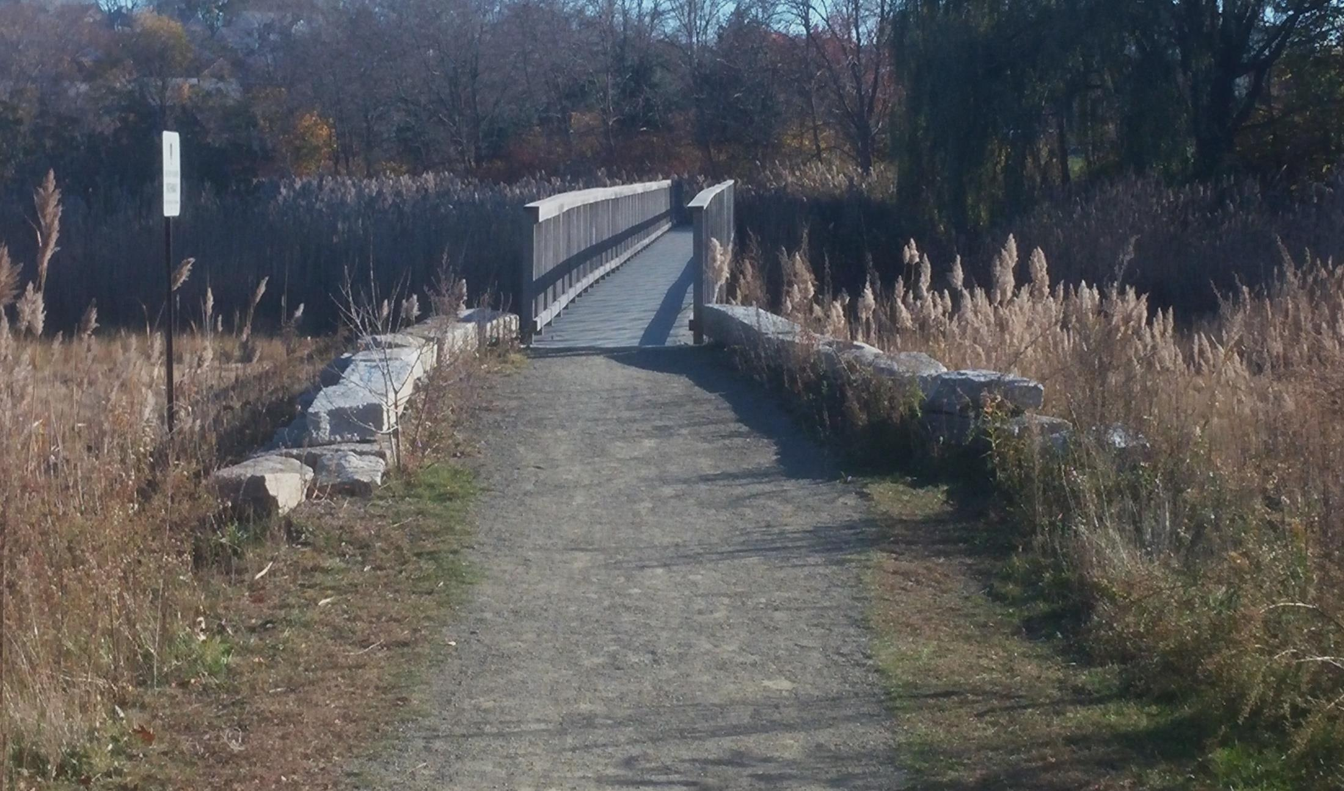
Anticipated Benefits
Continue development of the Walk Winthrop Plan
Encourage visitorship and tourism in Winthrop
Connect our region’s schools to the outdoor laboratory
Grow the economy around our natural resources
Develop stewardship and conservation in the region

Slide 5
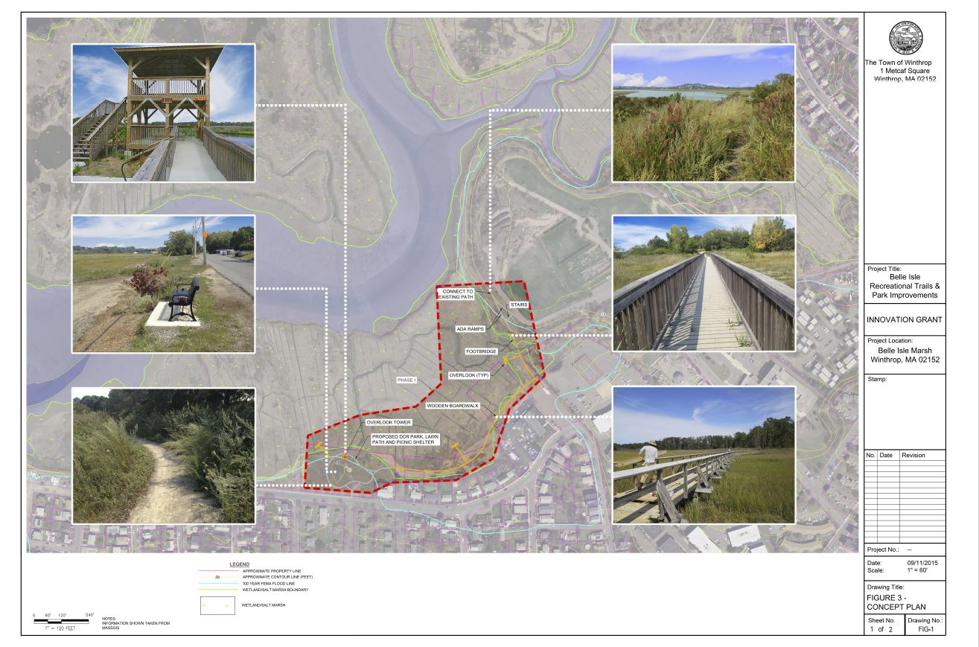

Slide 6
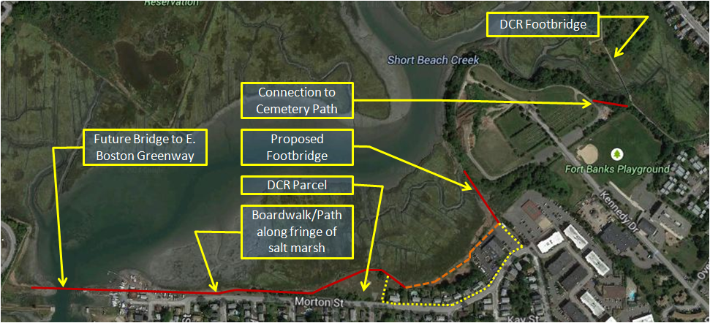

Slide 7
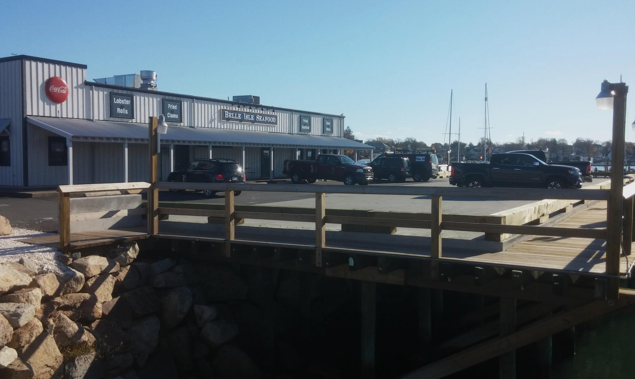
Project Breakdown
$1.2 million total project cost
Complete all construction by 2017
Environmental Conservation benefits
Economic Development benefits
New attraction for the region
Improve and care for the Marsh
New Public/Non-Profit Partnerships

