Slide 1
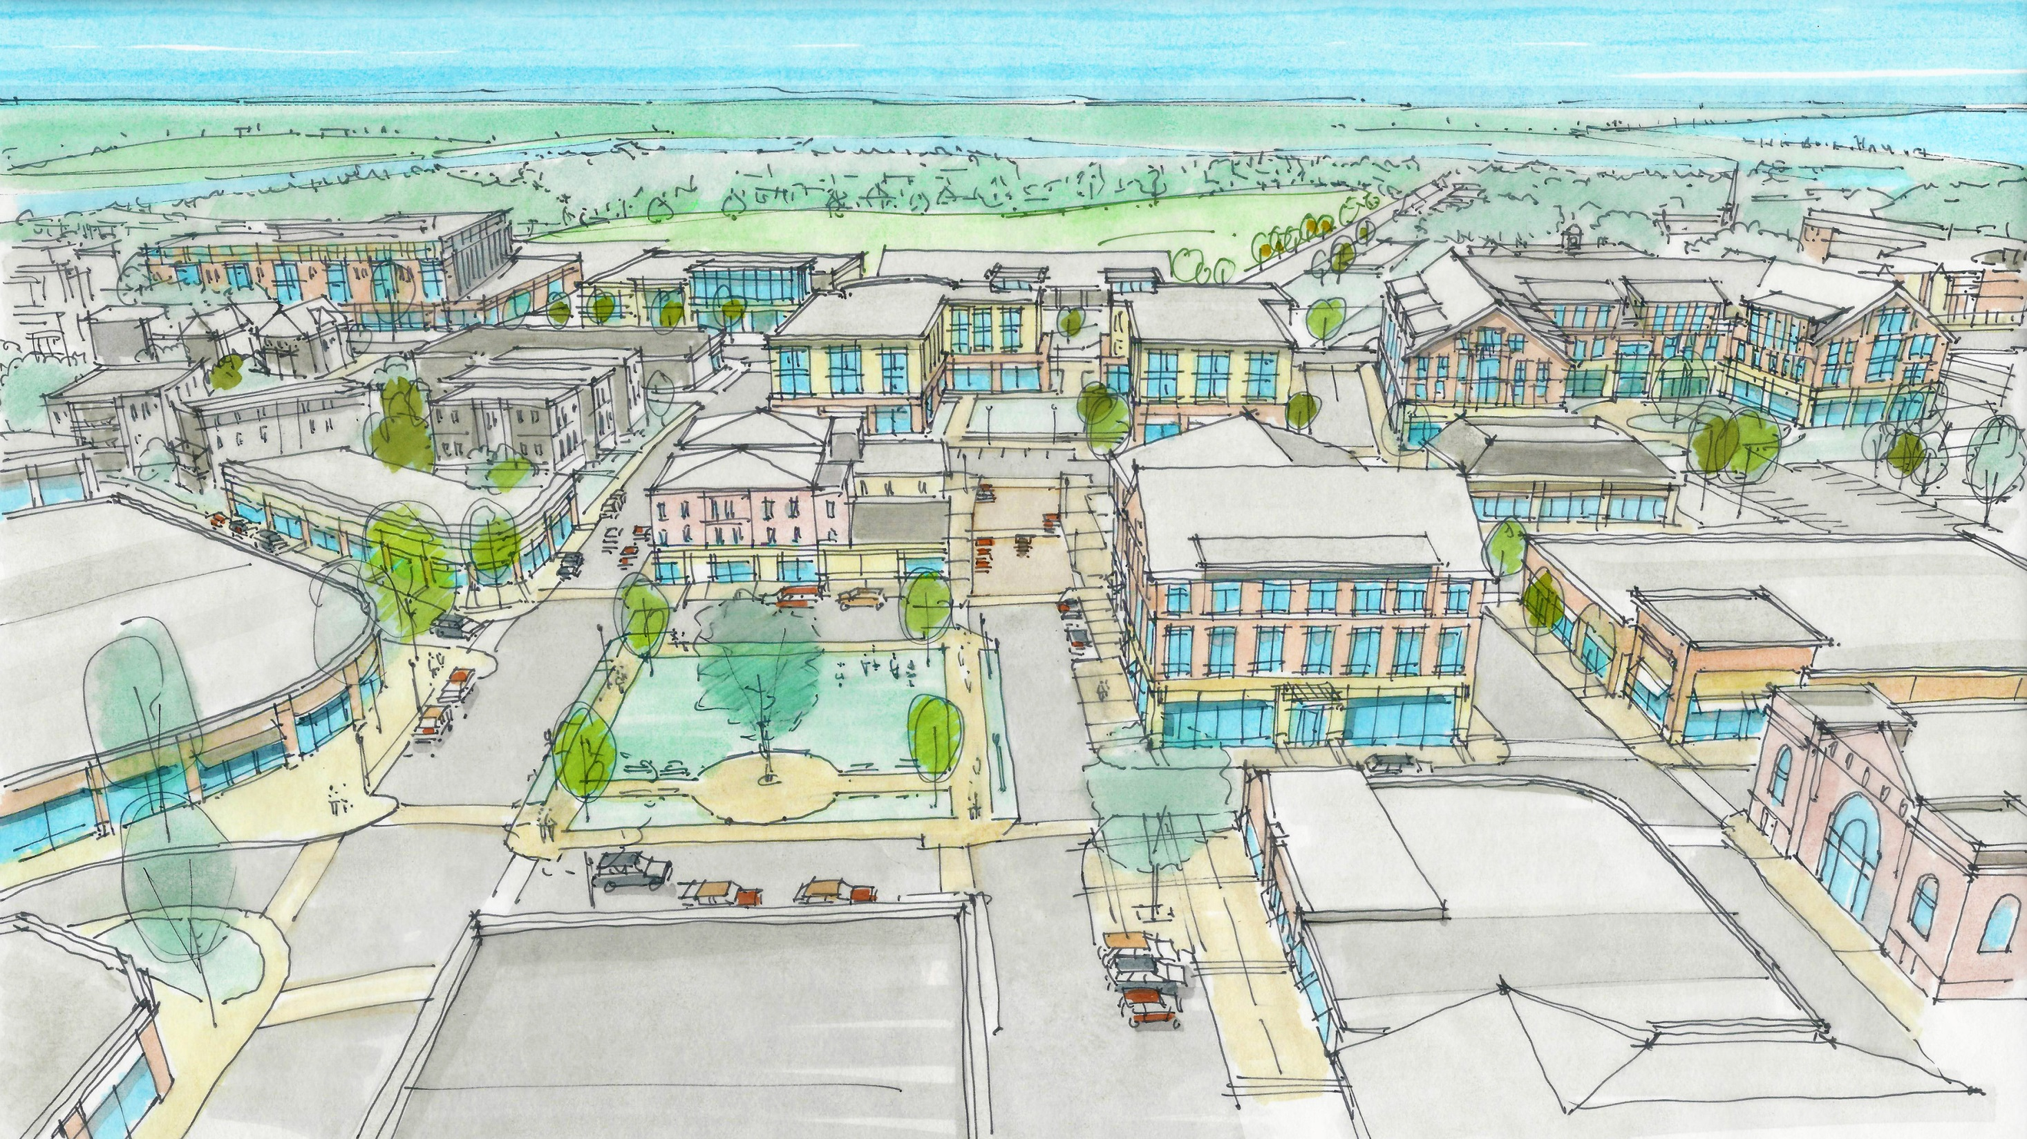

WINTHROP CBD MASTER PLAN & MIDDLE SCHOOL FEASIBILITY STUDY
Town of Winthrop, MA
MassDevelopment
Metropolitan Area Planning Council
Form + Place, Inc.
4 April 2017
Notes:
Cover slide – not part of PECHA KUCHA

Slide 2
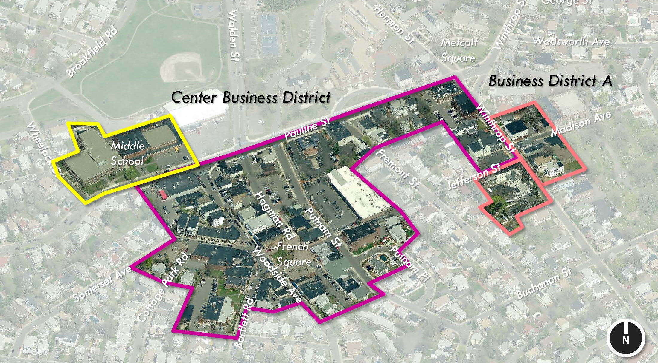
CBD & ADJACENT ASSETS
TOWN HALL / LIBRARY
INGLESIDE PARK
CULTURAL CENTER
FORMER MIDDLE
SCHOOL SITE
HOCKEY
RINK
FRENCH SQUARE
UMASS COLLINS REPORT
LOST JOBS / JOB OPPORTUNITIES
RETAIL LEAKAGE [68% OUT OF TOWN]
AGING POPULATION [33 TO 47]
UNUSUAL POPULATION DECLINE

Slide 3
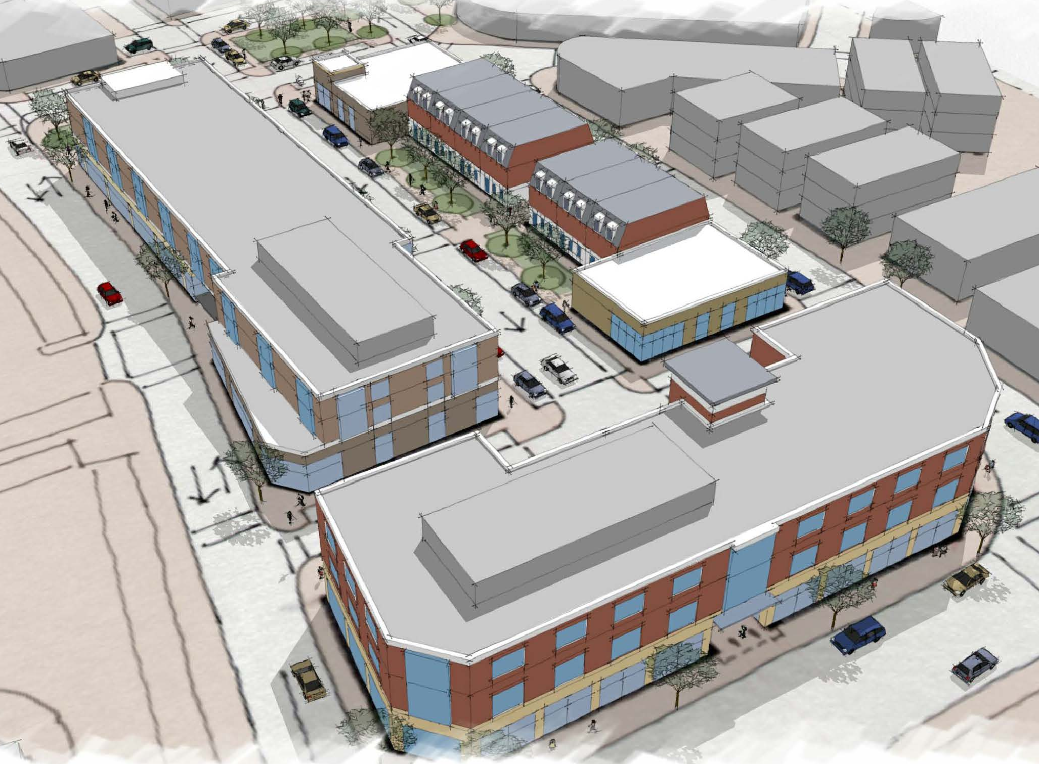
SUMMARY OF CBD MASTER PLAN PROCESS
INITIAL MEETINGS WITH TOWN MANAGER’S OFFICE [MARCH 2016]
TOWN COUNCIL APPOINTS EDCAC
COMMUNITY MEETING #1 [MAY 26, 2016]
  - VISIONING
COMMUNITY MEETING #2 [JUNE 28, 2016]
  - CBD ANALYSIS
  - MIDDLE SCHOOL FEASIBILITY CONCEPTS
COMMUNITY MEETING #3 [NOVEMBER 10, 2016]
- DRAFT PLAN / CASE STUDIES
- MASTER PLAN RECOMMENDATIONS
FINAL CBD MASTER PLAN REPORT [MARCH 2017]
2015 FEASIBILITY STUDY
Testing the new CBD zoning criteria
Notes:
Cover slide – not part of PECHA KUCHA

Slide 4
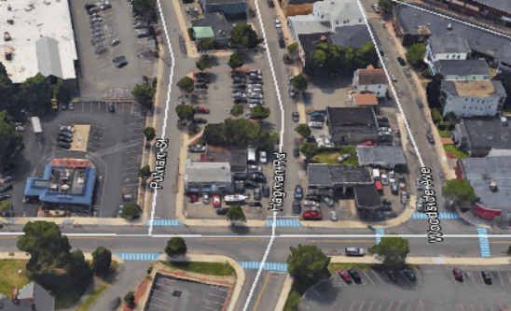
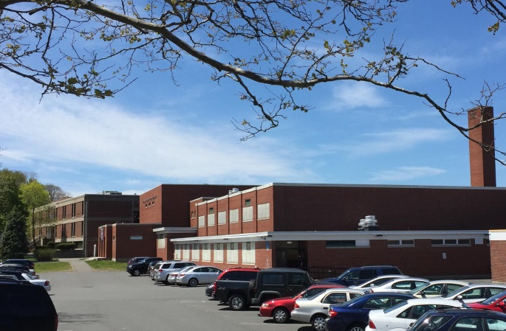
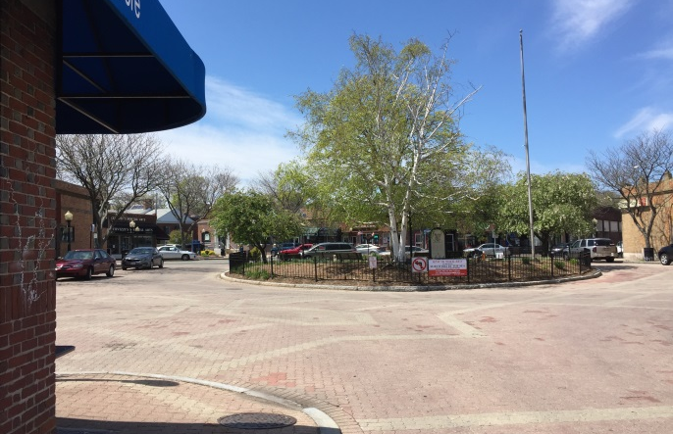
KEY FINDINGS
CHALLENGING BLOCK STRUCTURE IN THE CBD – PARCEL SIZE AND GEOMETRIES
STREETSCAPES / PEDESTRIAN ENVIRONMENT NARROW & LACKING CONTINUITY DUE TO EXCESSIVE CURB CUTS
THERE IS A NEED FOR USABLE PUBLIC OPEN SPACE
DESPITE NEW ZONING, BUILDINGS LARGELY ONE AND TWO-STORY AND LACKING CONSISTENT COMMERCIAL STOREFRONT ARTICULATION
PARKING STUDY CONCLUDES THAT SUPPLY IS GREATER THAN CURRENT DEMAND
MIDDLE SCHOOL FEASIBILITY STUDY UNDERLINES OPPORTUNITY FOR CATALYZING PROJECT; REVEALS CHALLENGES / COSTS OF ADAPTIVE REUSE OF EXISTING BUILDINGS
CBD BLOCK
STRUCTURE
FORMER MIDDLE SCHOOL SITE
FRENCH SQUARE
Notes:
Cover slide – not part of PECHA KUCHA

Slide 5
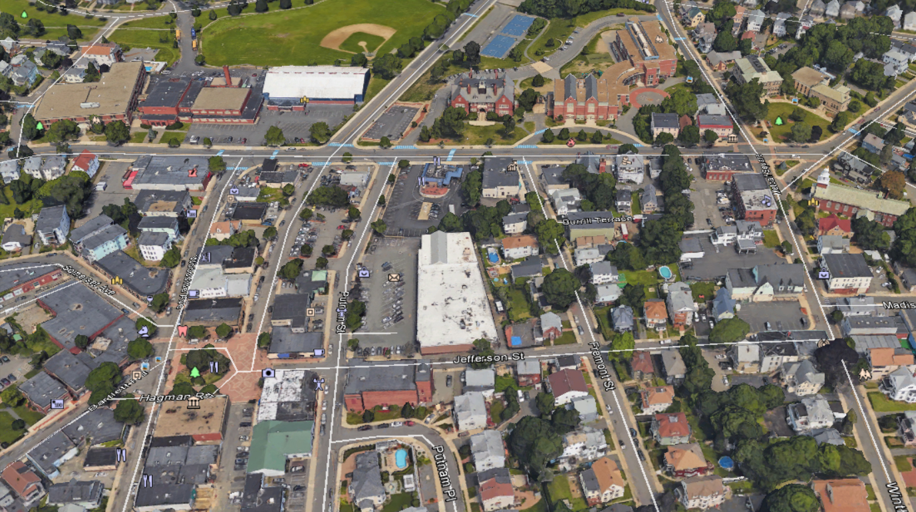
CASE STUDIES
CBD MASTER-PLAN RECOMMENDATIONS
ENHANCE PUBLIC REALM
connectivity / open space / streetscapes
INCREASE RESIDENTIAL DENSITY
typologies to attract diverse demographic
STRENGTHEN BUSINESSES
mixed-use / community-based & destination
PROMOTE THOUGHTFUL DEVELOPMENT
guidelines: block structure / visual character
DEVELOP FUNDING STRATEGIES
identify priority projects / tools & methods
CATALYZING
PROJECT
GATEWAY TO THE
CBD
PUBLIC
REALM
Notes:
Cover slide – not part of PECHA KUCHA

Slide 6
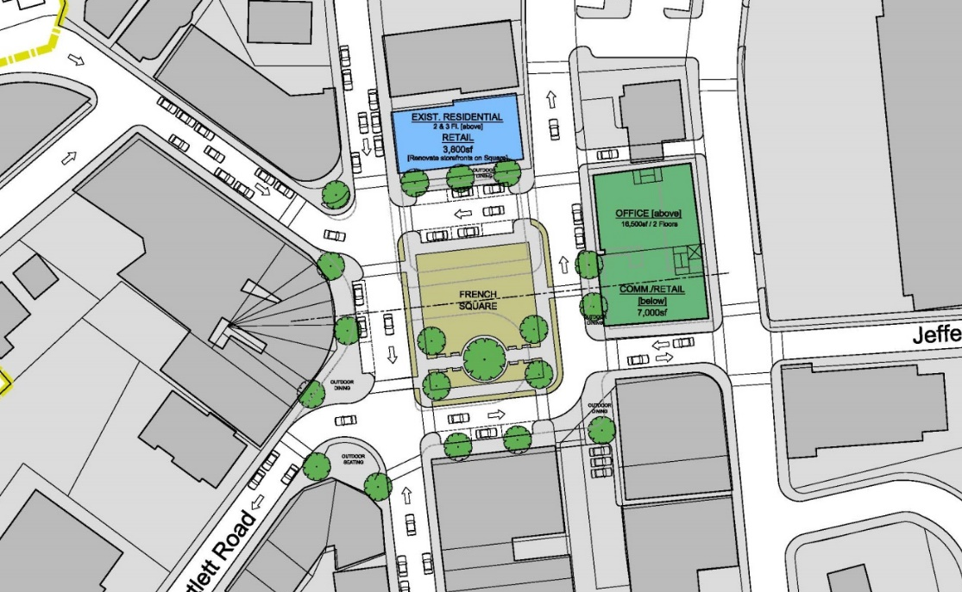
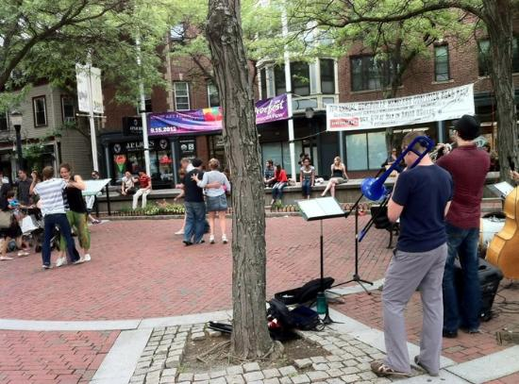
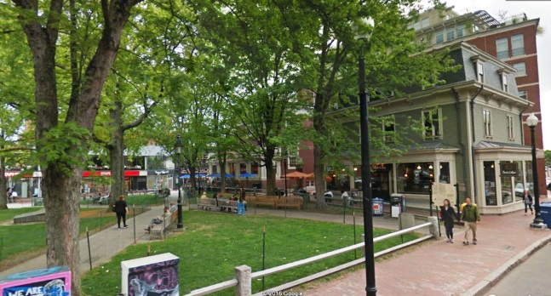
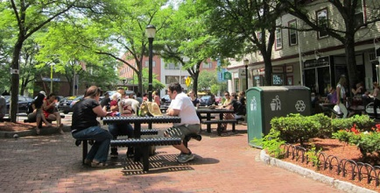
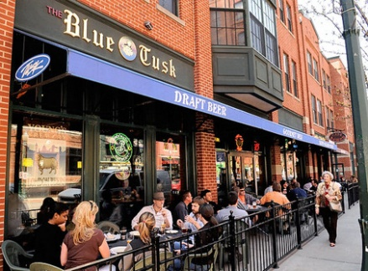
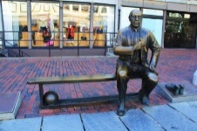
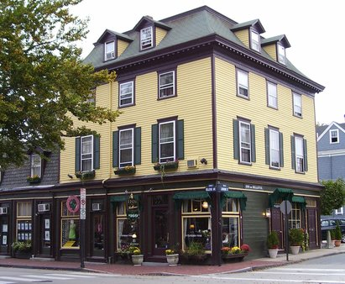
CASE STUDY 1: THE SQUARE [Phase III]
A usable public realm that engages the built environment and provides a focal point for the community

Slide 7
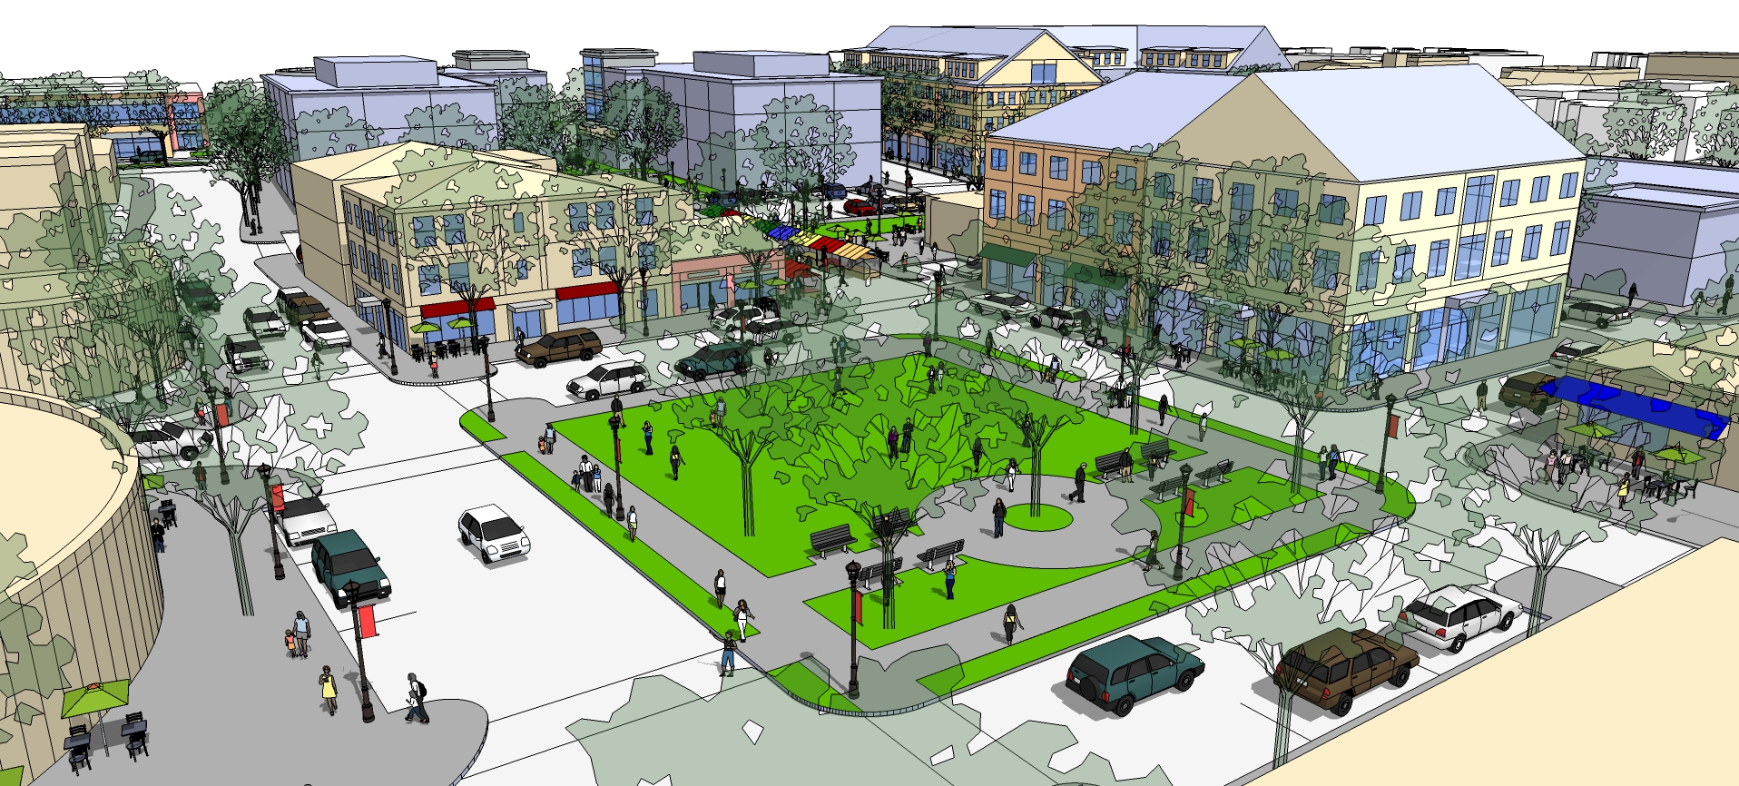
CASE STUDY 1: THE SQUARE [Phase III]

Slide 8
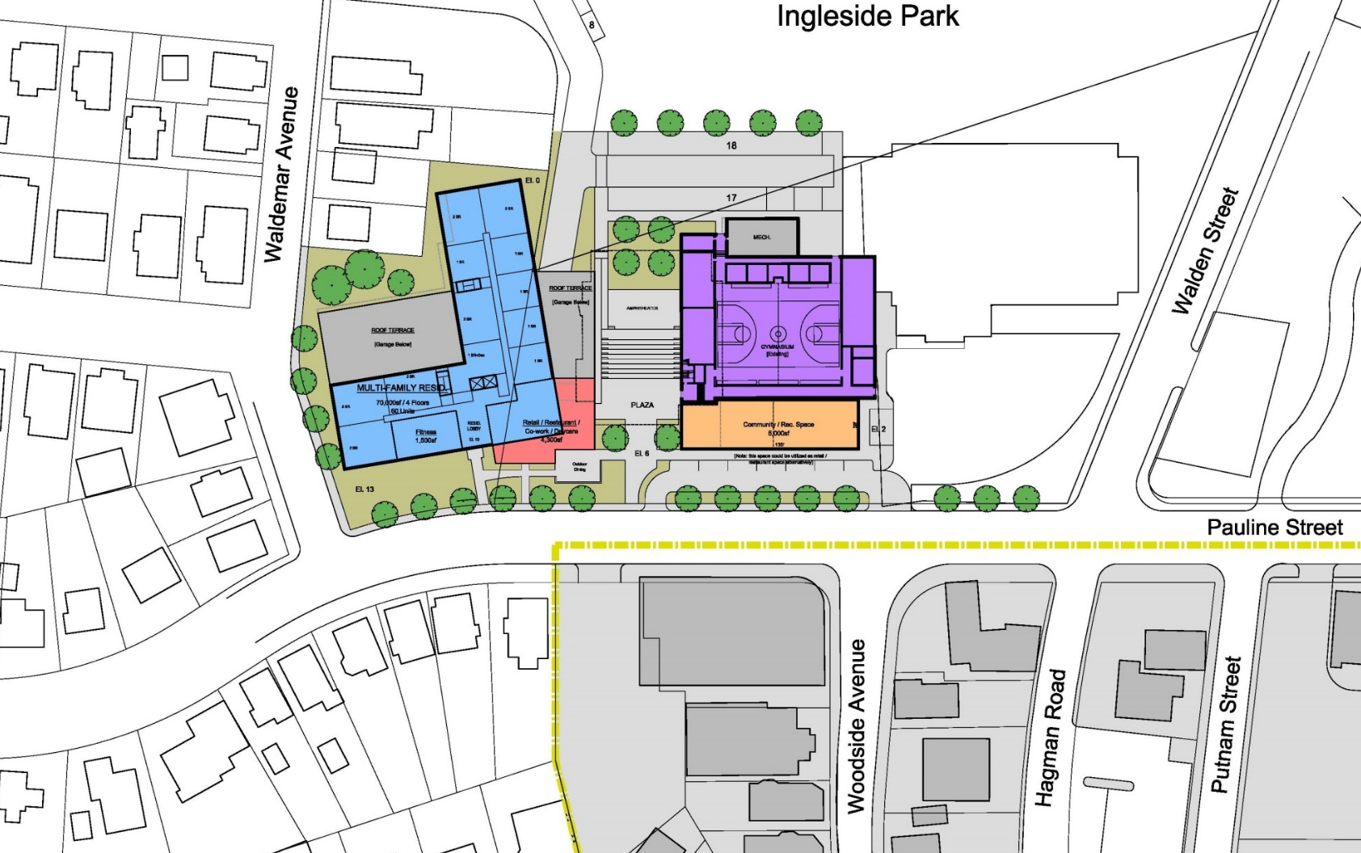
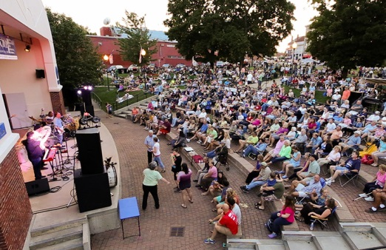
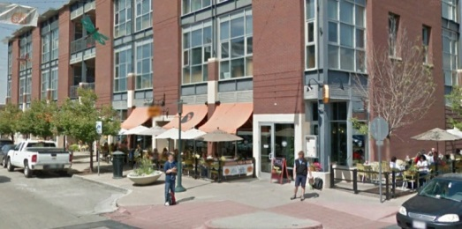
CASE STUDY 2: MIDDLE SHOOL SITE
Hockey Rink
CATALYZING PROJECT:
Balancing mixed use: residential, commercial & community space
Enhanced public realm / Programmable open space
Connecting assets: Ingleside & The Square
Appropriate scale & character for Winthrop

Slide 9
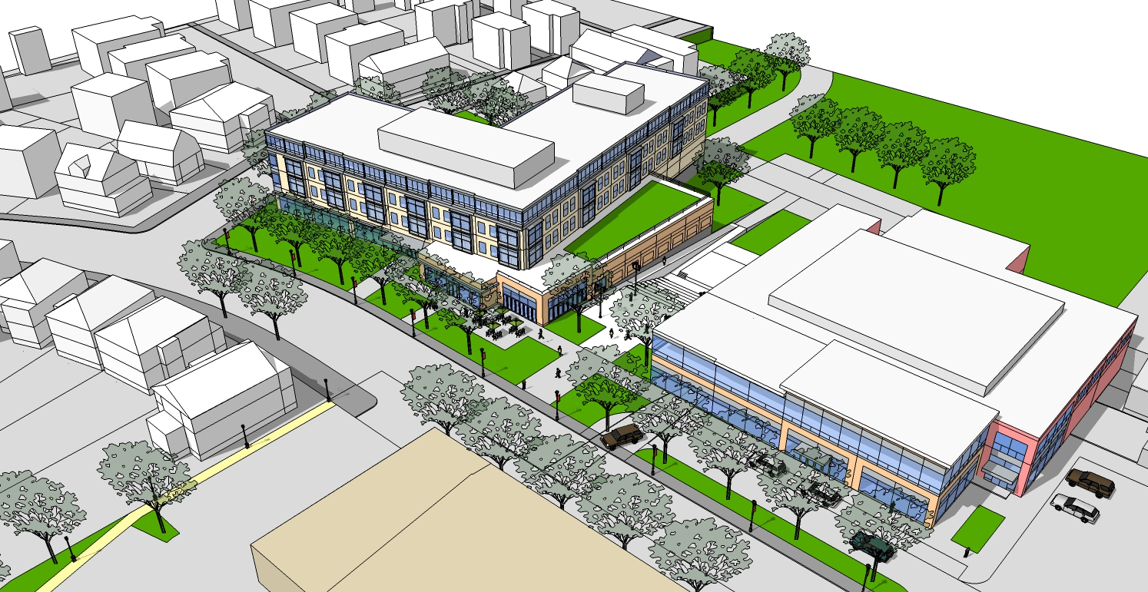
CASE STUDY 2: MIDDLE SHOOL SITE

Slide 10
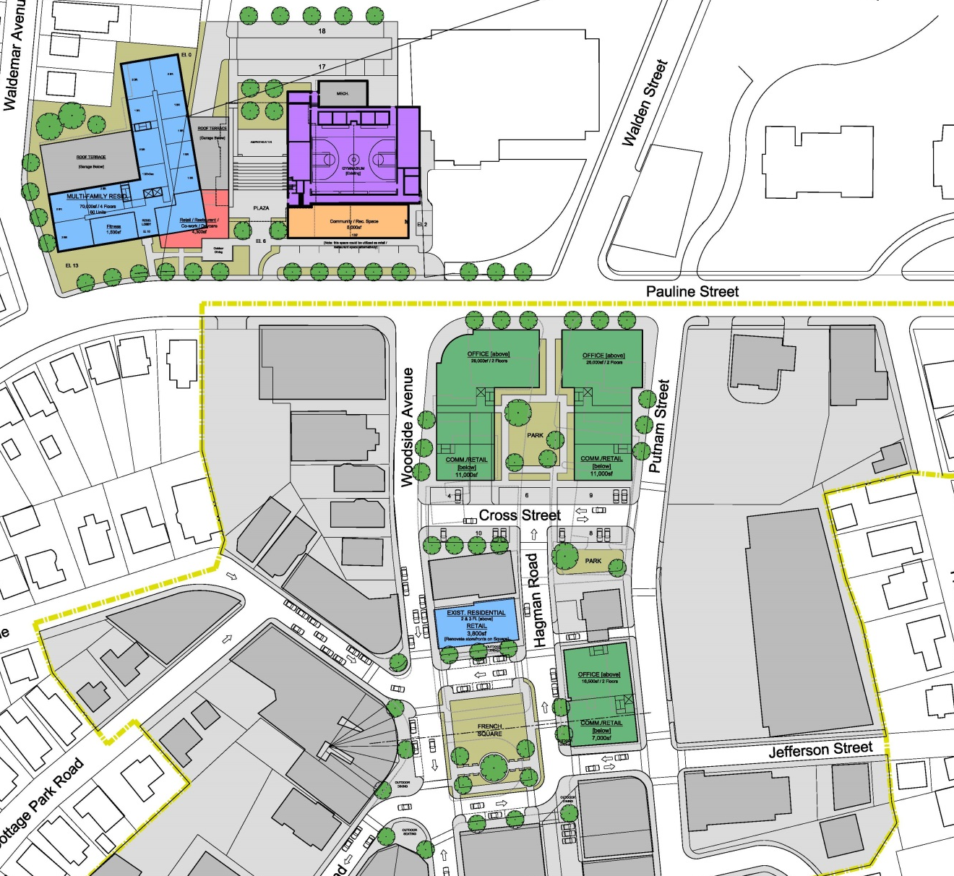
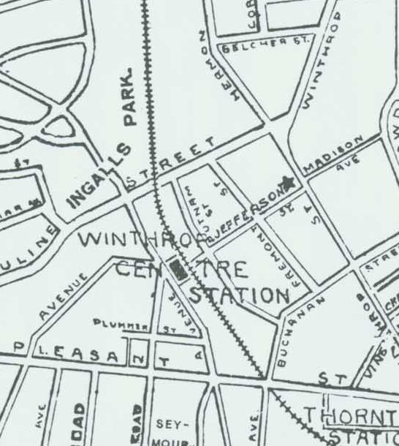
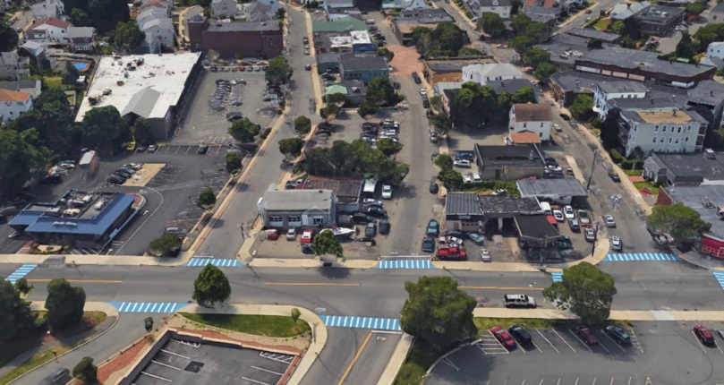
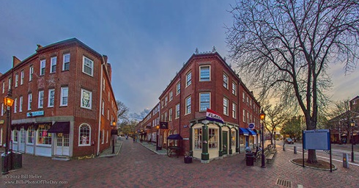
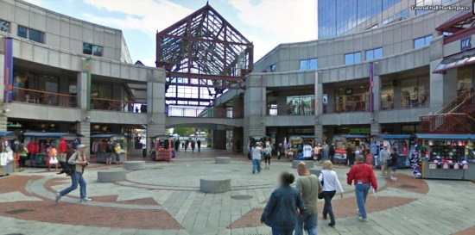
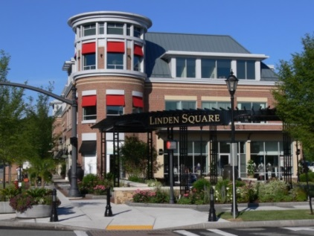
CASE STUDY 3: GATEWAY TO THE CBD
Gateway to the CBD:
Sense of arrival
Visual corridors
Connectivity & pedestrian environments
Parcel size/Scale/Character

Slide 11
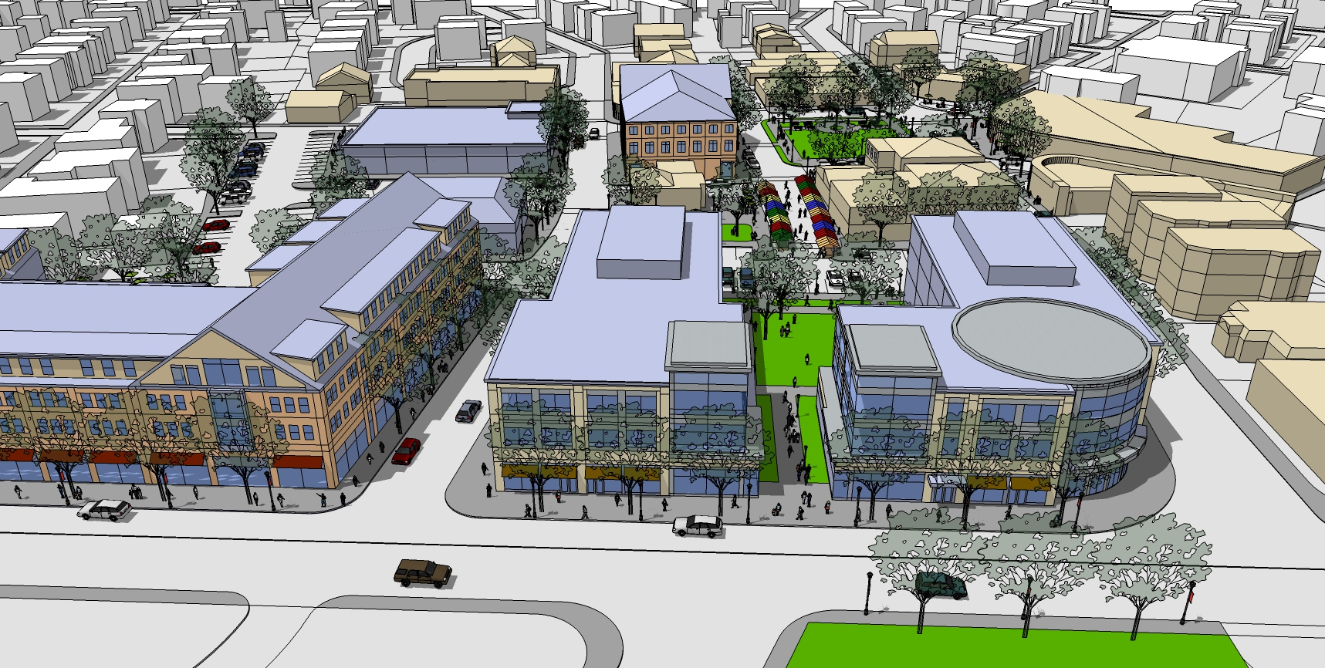
CASE STUDY 3: GATEWAY TO THE CBD

Slide 12
NEXT STEPS
TOWN COUNCIL ADOPTS CBD MASTER PLAN
DETERMINE ORGANIZATIONAL STRUCTURE / PRIORITIZATION & OVERSIGHT
CLARIFY COMMUNITY’S GOALS FOR DEVELOPMENT ON THE MIDDLE SCHOOL SITE
EXECUTE APPROPRIATE ZONING FOR MIDDLE SCHOOL SITE
FORMALIZE APPROACH FOR DISPOSITION OF MIDDLE SCHOOL SITE [PUBLIC-PRIVATE PARTNERSHIP]
FINALIZE STRATEGY FOR PUBLIC REALM IMPROVEMENTS & IMPLEMENT COMPLETE STREETS
CONTINUE WORKING TO UPGRADE CBD INFRASTRUCTURE
IDENTIFY MOST RELEVANT FUNDING STRATEGIES – MASSWORKS, ETC.

Slide 13
THANK YOU
WINTHROP CBD MASTER PLAN & MIDDLE SCHOOL FEASIBILITY STUDY
Town of Winthrop, MA
MassDevelopment
Metropolitan Area Planning Council
Form + Place, Inc.
4 April 2017
Notes:
Cover slide – not part of PECHA KUCHA

