Slide 1
Winthrop Center
Revitalization Project

Slide 2
History
2014-2015 – Economic Development Strategic Planning process with McCormack Institute.
April 2015 – Manager hired urban planning and design firm to create a visual rendering.
October 2015 – Applied and Received Urban Agenda Grant to prepare a plan for CBD and Middle School site.
2016 – CBD Master Plan process was conducted.
September 2016-MassWorks Grant applied for
April 2017 – Town Council adopted the Master Plan.
July 2017 – Governor and Executive Office of Housing and Economic Development awarded Winthrop $2.38 million dollars to support the development in Winthrop Center.

Slide 3
Project Timeline
The following is a project timeline beginning with preparation meetings leading up to the deployment of the National Grid Gas Crews and continuing through completion of the project. Excluded from this time line is the Economic Development Strategic Planning process. We also feel that it is most important to caution the readers of this document that a delay in any portion of this project to include funding invalidates this time line and must be updated in accordance with those delays:

Slide 4
Project Timeline
National Grid commitment for utilities Sept/Oct 2016
Submitted to Council hardscape March 2017
National Grid electric April 2017, discussed underground electric lines
National Grid gas began work April 2017
Public meeting at EB Newton since March 2017 and continues
$2.38 million Award June 21, 2017
Town Manager authorized Woodward and Curran to complete the design the week of 7/17/17
Traffic Pilot August 2017
30 days for design work estimated September 2017
30 days of bid prep estimated October 2017
30 days to award November 2017
Start Sewer Utility November 2017
Water work to begin Spring 2018
Anticipate all water, sewer and storm drain completed by October 2018
Street and sidewalk to begin in April 2019.
Street and Sidewalk anticipate completion by August of 2019
Landscape to begin in Spring of 2019
Project close out Fall 2019

Slide 5
Secured Funding
State
$2.38 million MassWorks
$200,000 Chapter 90
MWRA
$2 million MWRA, Water Main Funds
$500,000 MWRA Sewer Funds

Slide 6
Unsecured Sources of Funding/ Potential Bonding
$400,000 Complete Streets
$2,000,000 State Revolving Funds (for Clean Water SRF and Drinking Water SRF)
$175,000 Coastal Zone Management Storm Water/Coastal Pollution Remediation
$800,000 Community Development Block Grant (CDBG, does not open until March 2018)
Each of these funding sources is highly competitive and should not be counted on at this stage.
Potential funding needed through bonding
$1.02 million to $3.42 million will be needed from general bonding, depending on the success of Complete Streets, SRF and the other grant applications.
Warning : Based on cost estimates provided to the town by our engineers and based on recent similar work performed in other areas of the town, the budget for the Center Business District infrastructure project currently has been established at $8.5 million.
It does NOT include estimated costs associated with putting the remaining electricity, and fiber optics lines below ground.

Slide 7
Project Operations
Goal is to minimize disruptions and impacts to businesses and residents
Additional goal to not increase costs of construction
Specifications will/can include which streets to start with.
There will be no water, sewer, drainage work on Pleasant Street except for tie-ins

Slide 8
Streets, Sidewalks, Water, Sewer and Drainage:
Starting in the Spring of 2018 entire area will be on water bypass.
Scope of the Project:
Woodside from Pauline to Pleasant to include French Square
Bartlett from Woodside to Putnam
Somerset from Pleasant to Woodside
Cottage Park from Pleasant to Somerset
Jefferson from Woodside to Putnam
Hagman entire length
Adams from Woodside to Williams
Williams entire length

Slide 9
Street and Sidewalk Only:
Municipal lot by Citizen Bank
Putnam Street
Hagman Road parking lot

Slide 10
Town Manager/Council matters
In order for this project to move forward at the projected timeline and cost the following actions are necessary by either the Town Manager or Town Council immediately.
Vote traffic pilot project
Vote to authorize TM/CFO to appropriate $8.5 million project from all available sources
Hardscape design which was submitted to Town Council in March 2017 and engineering authorized by the Town Manager on July 17, 2017 based on the final version of the hardscape that is attached to this document, counsel vote to affirm hardscape plan.
Commitment letters and appropriation to authorize engineering for National Grid Electric, Verizon and Comcast to move utilities below ground and an additional authorization for $500,000 to move electric below ground.

Slide 12
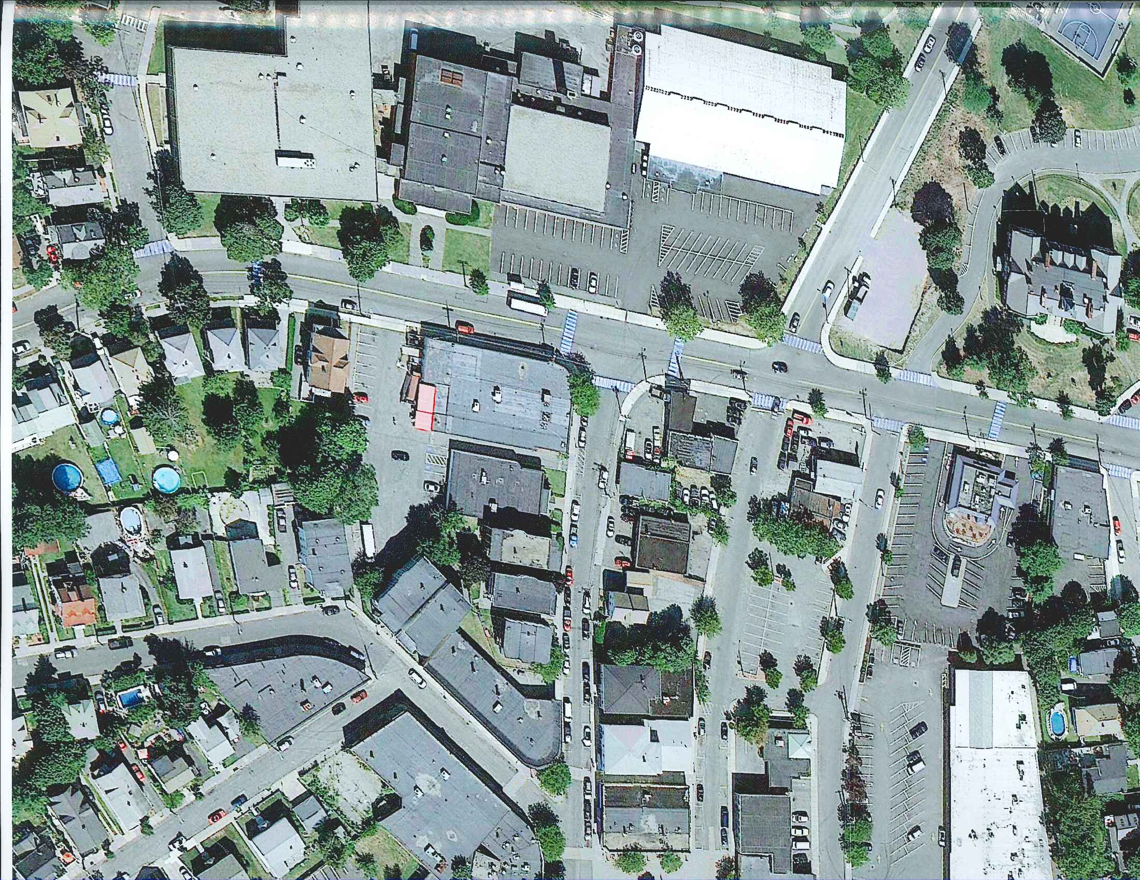
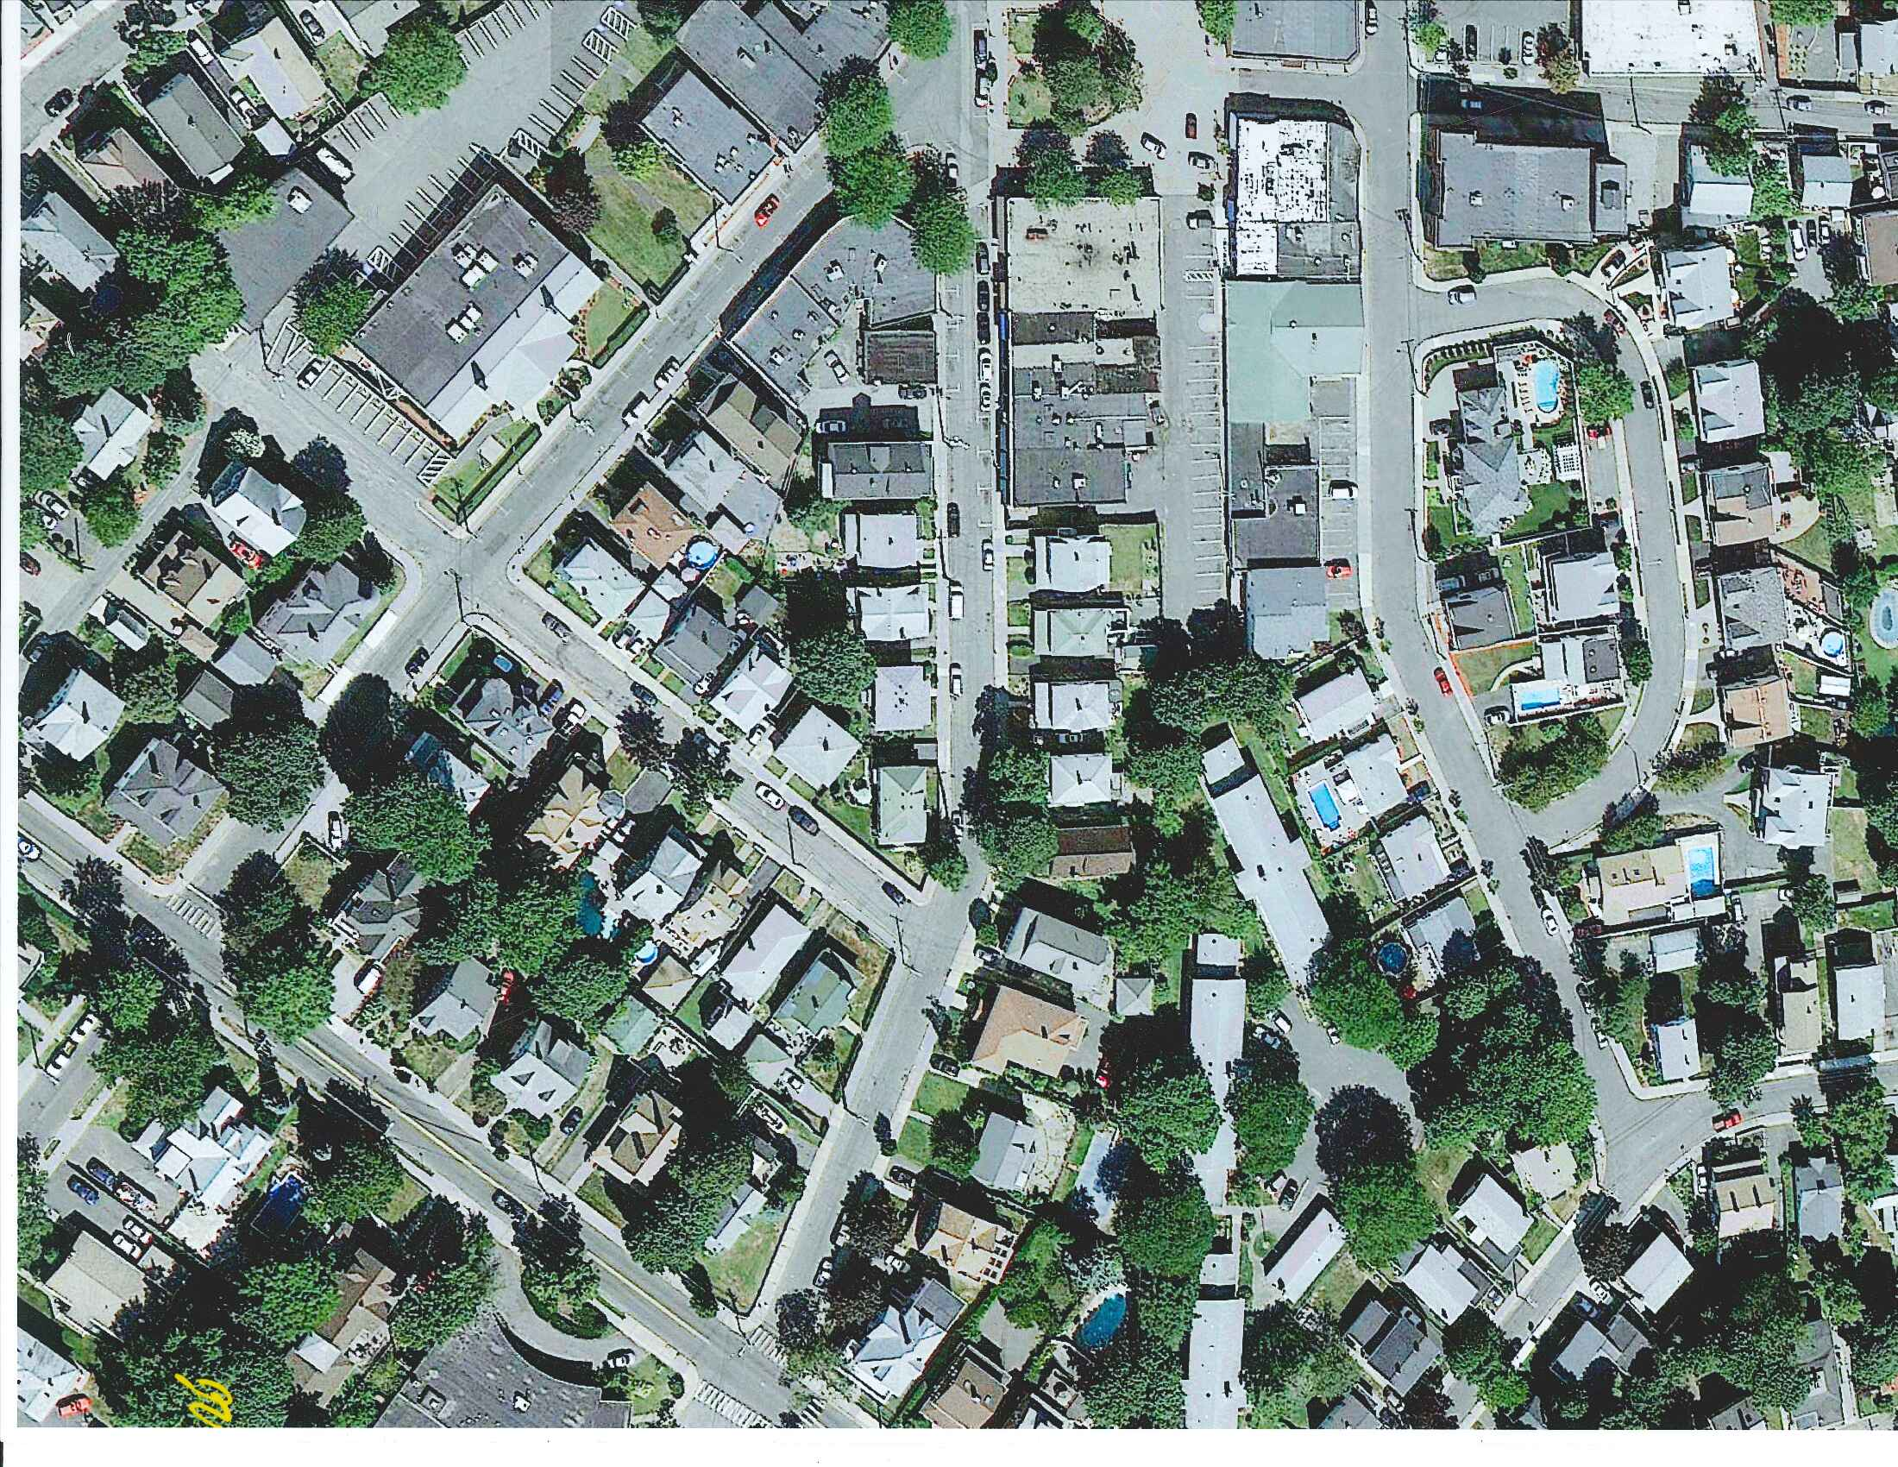
Reverse Adams
Allow right and left turns
One way
Closed for through traffic

