Slide 1
Winthrop, MA
Community Resiliency Building | Listening Session
May 8, 2018

Slide 2
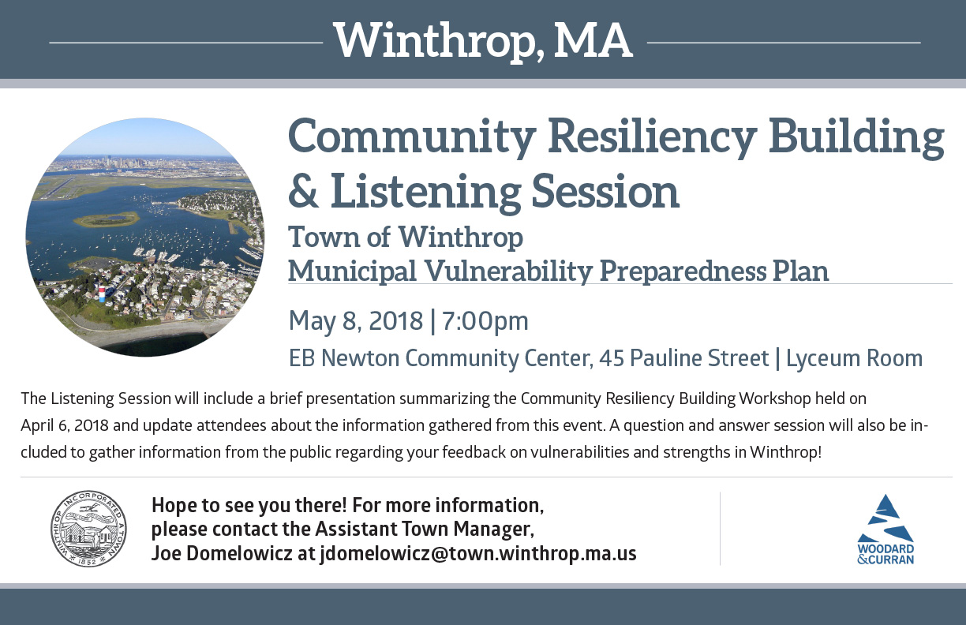
Agenda
Overview of Community Resiliency Building Workshop & Summary of Findings
Question & Answer
Note: Please utilize the notecards available to share any concerns or ideas that you have and would like to make sure are documented as a part of this process. Thank you!

Slide 3
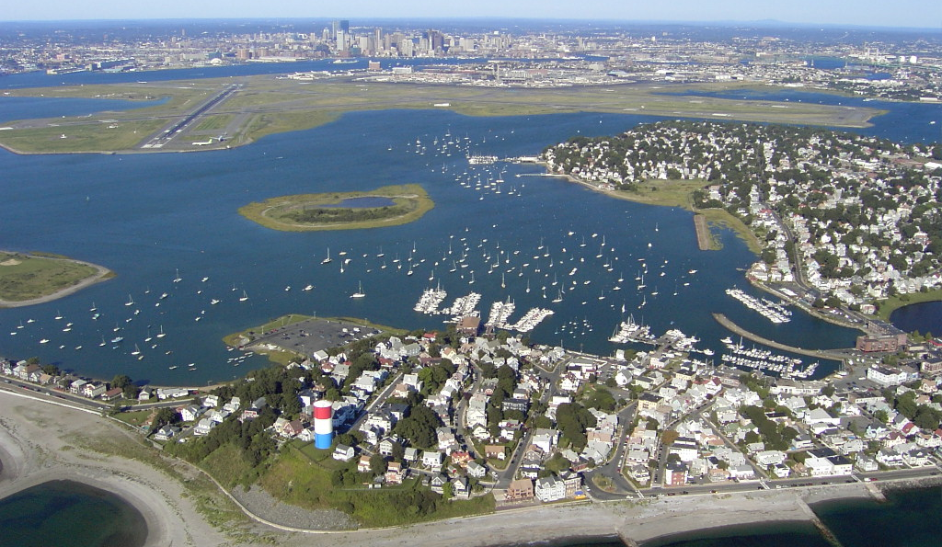
Background Information

Slide 4
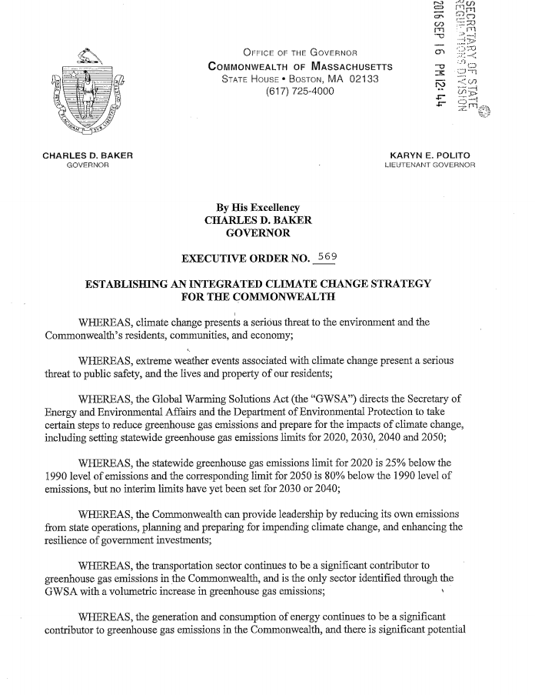
Executive Order 569
In September 2016, Governor Charlie Baker signed Executive Order 569, instructing state government to provide assistance to cities and towns to complete climate change vulnerability assessments and resiliency planning.

Slide 5
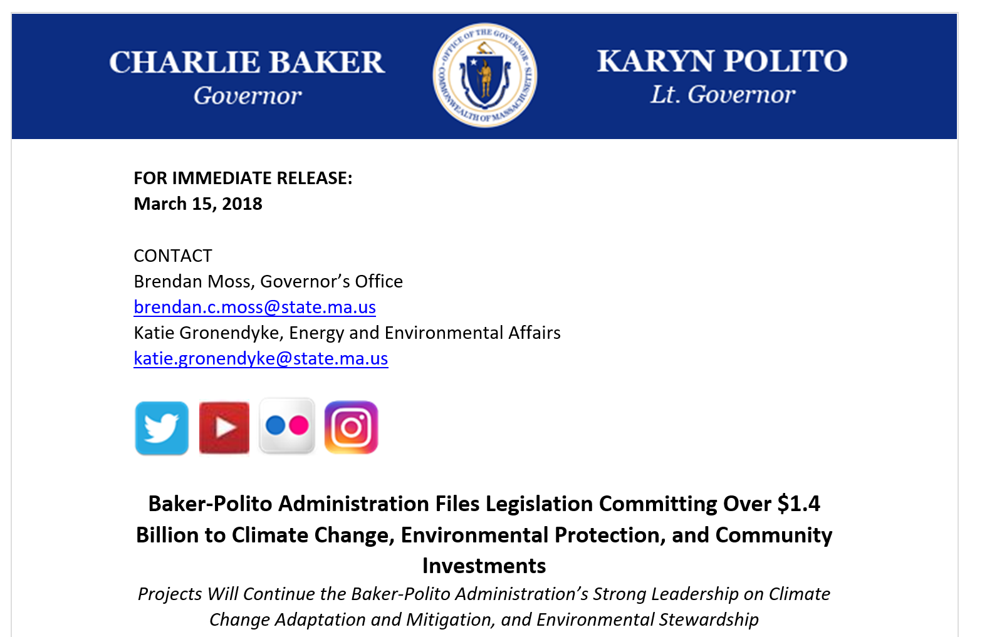
March 2018 Legislation
Baker/Polito filed $1.4B legislation to authorize investments for safeguarding municipalities from the impacts of climate change, protecting environmental resources, and investing in communities.
Hearing on the Bond Bill held on April 3rd to see if there is enough money available.

Slide 6
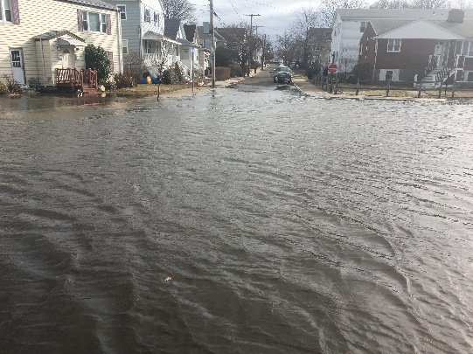
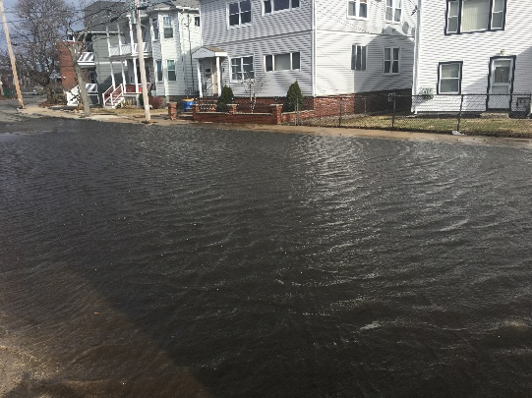
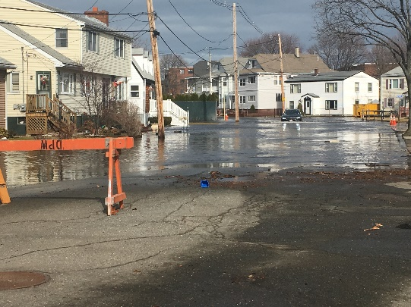
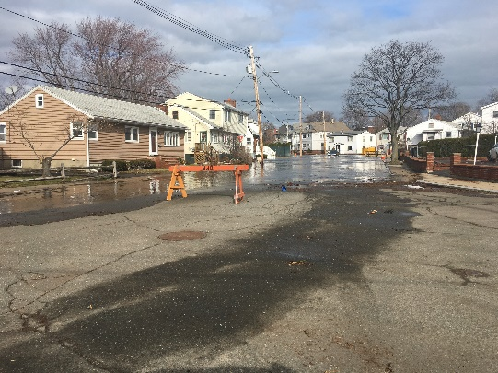
Municipal Vulnerability Preparedness (MVP) Grant Program
The MVP grant program provides support for cities and towns in Massachusetts to begin or continue the process of planning for resiliency.
The state awards communities with funding to complete vulnerability assessments and develop action-oriented resiliency plans.

Slide 7
Municipal Vulnerability Preparedness (MVP) Grant Program
The program helps communities achieve the following objectives:
Define extreme weather and natural and climate related hazards
Identify existing and future vulnerabilities and strengths
Develop and prioritize actions for the community
Identify opportunities to take action to reduce risk and build resilience

Slide 8
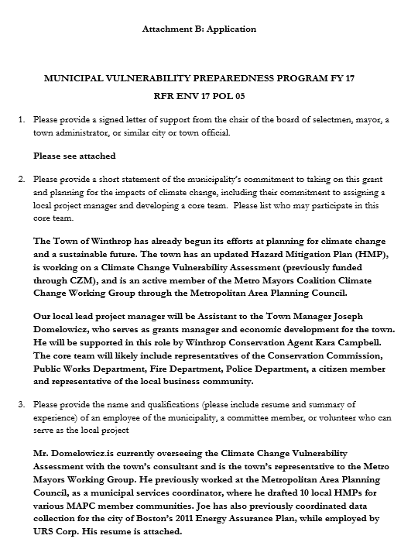
MVP Planning Grant Program
Winthrop proactively applied for the 2017 round
Was awarded $15,000 grant
Partnered with MVP Technical Services provider Woodard & Curran
Resulted in the Community Resiliency Building Workshop, Listening Session & Summary of Findings

Slide 9
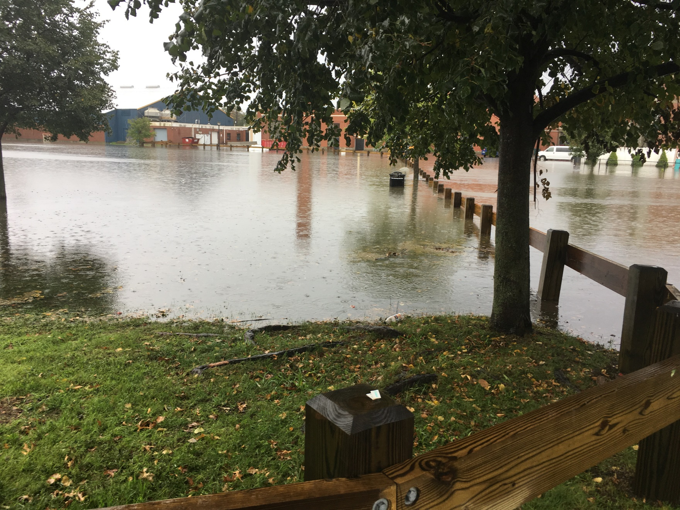
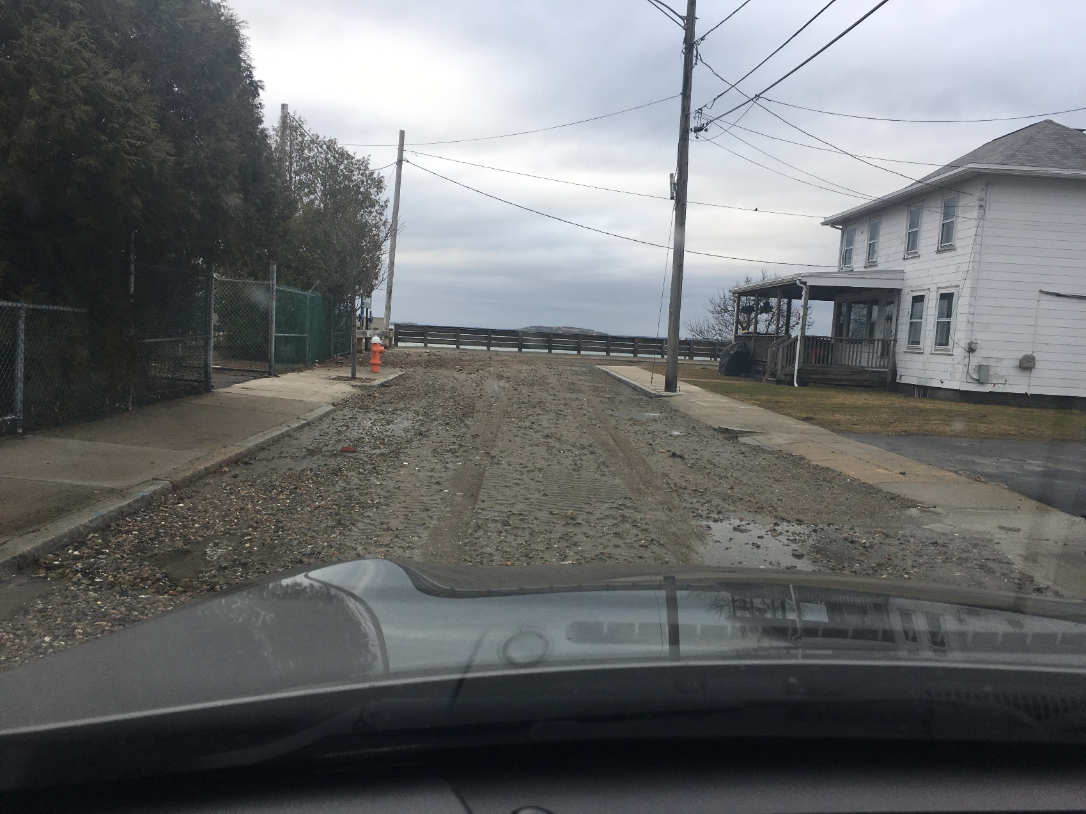
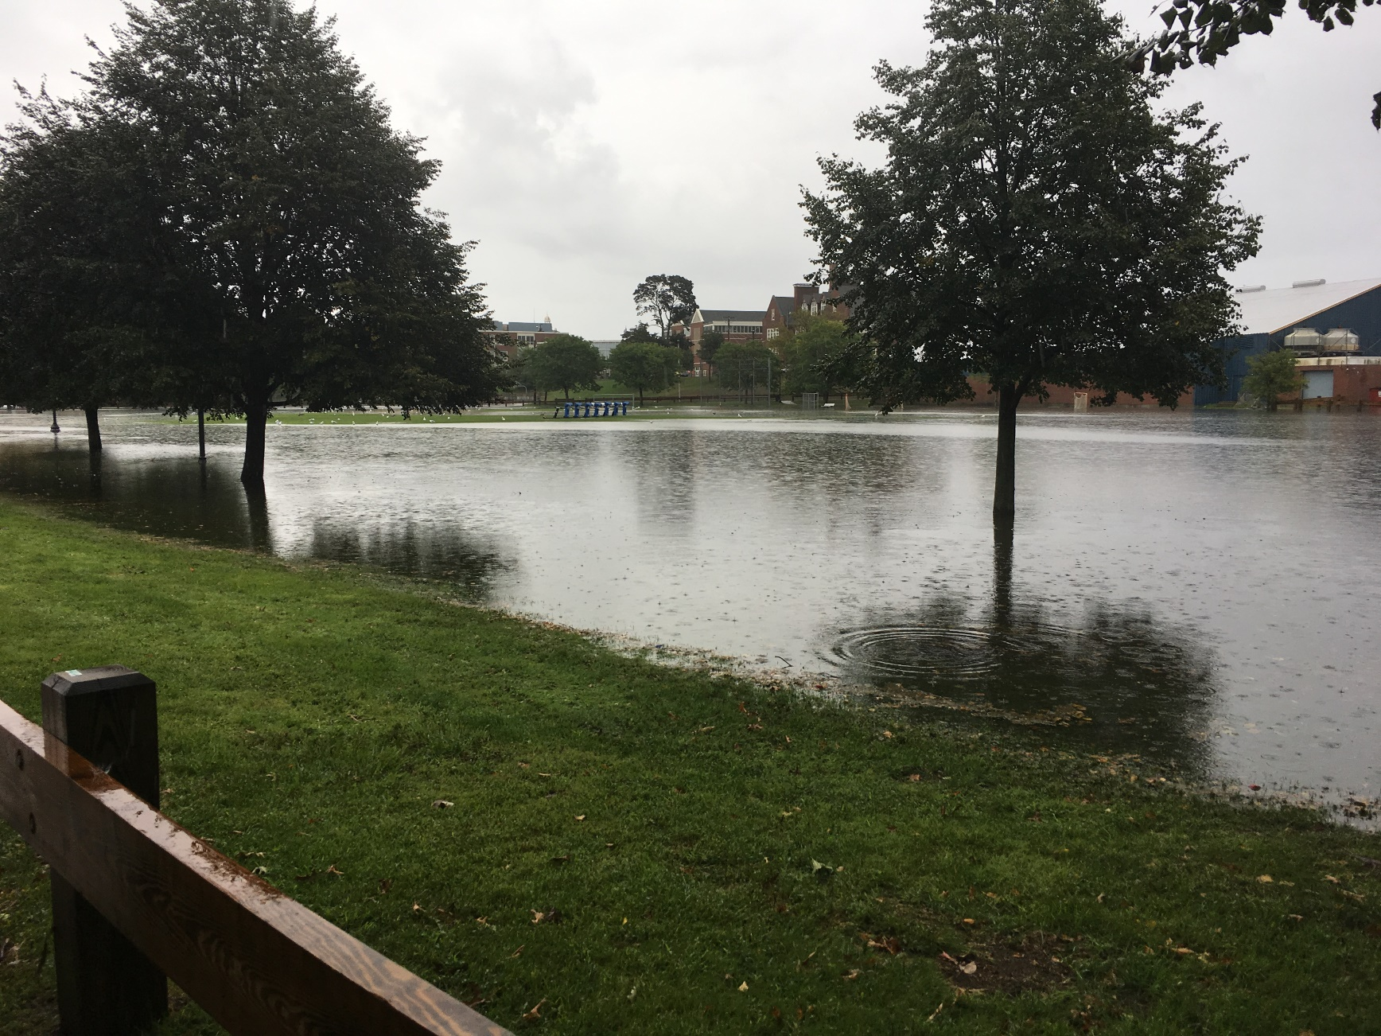
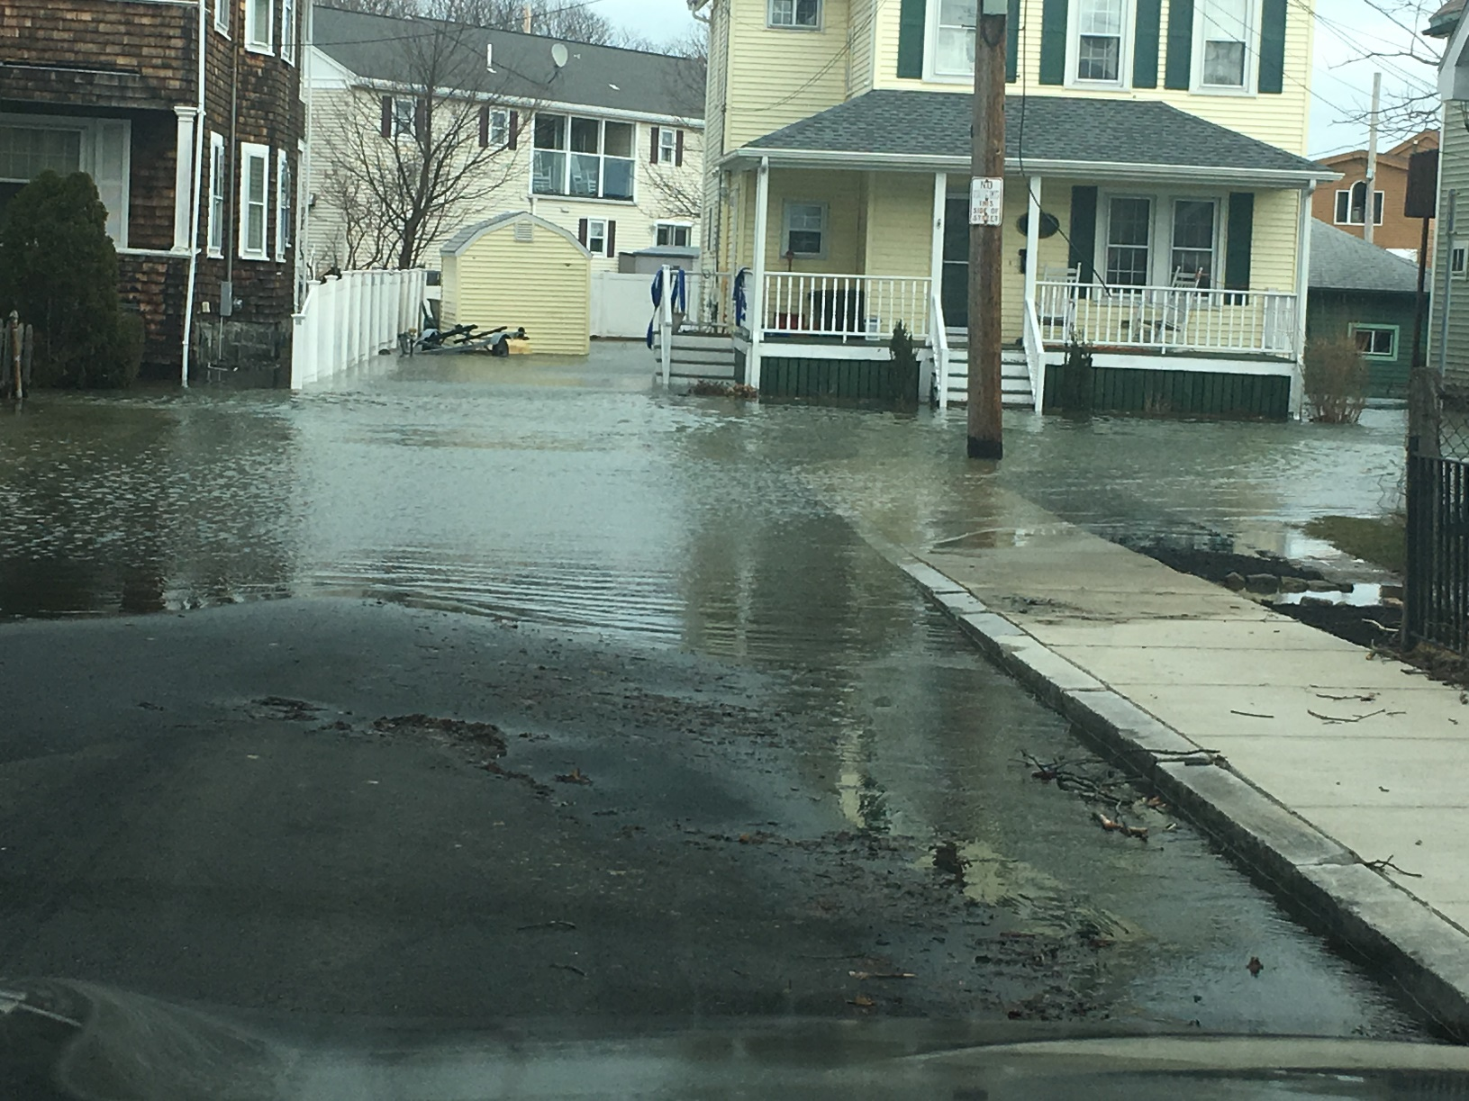
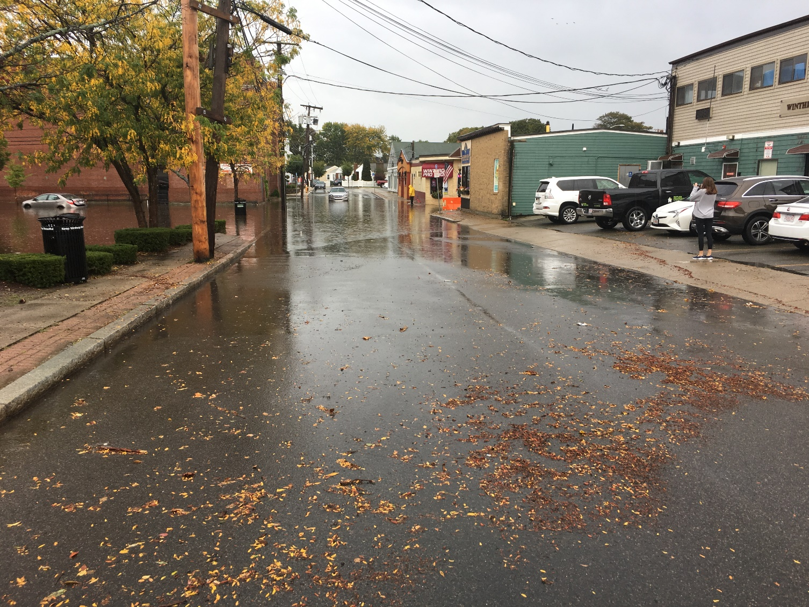
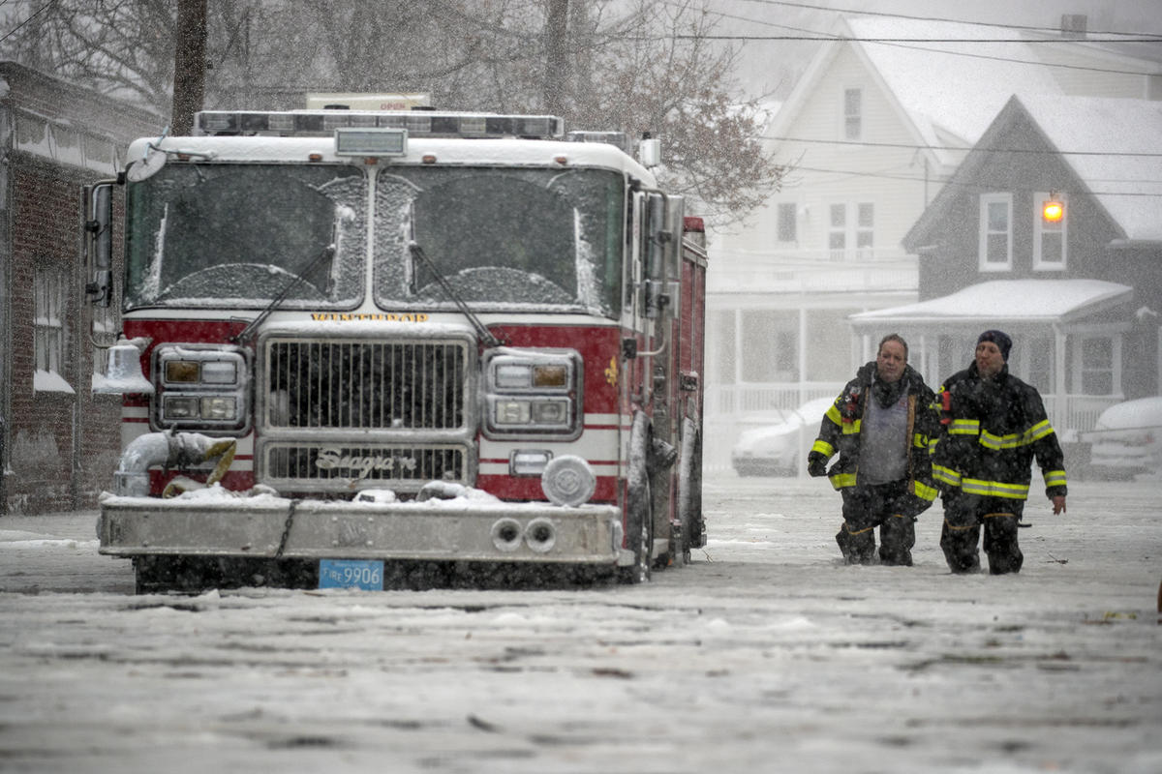
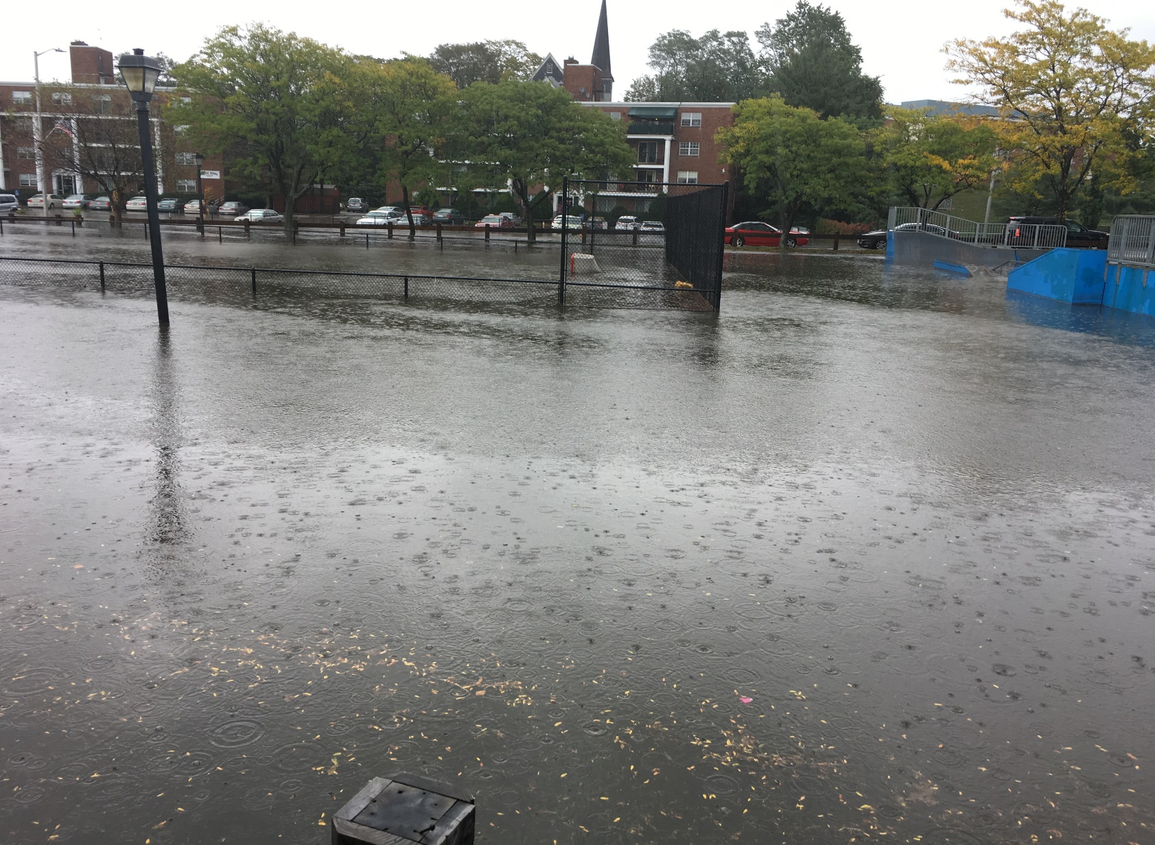
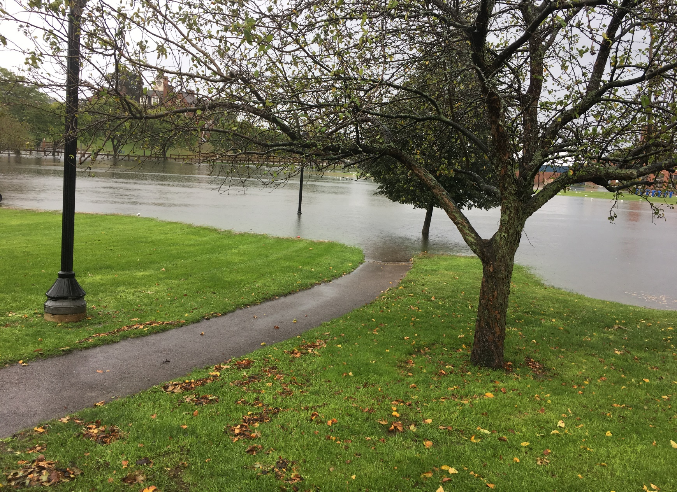


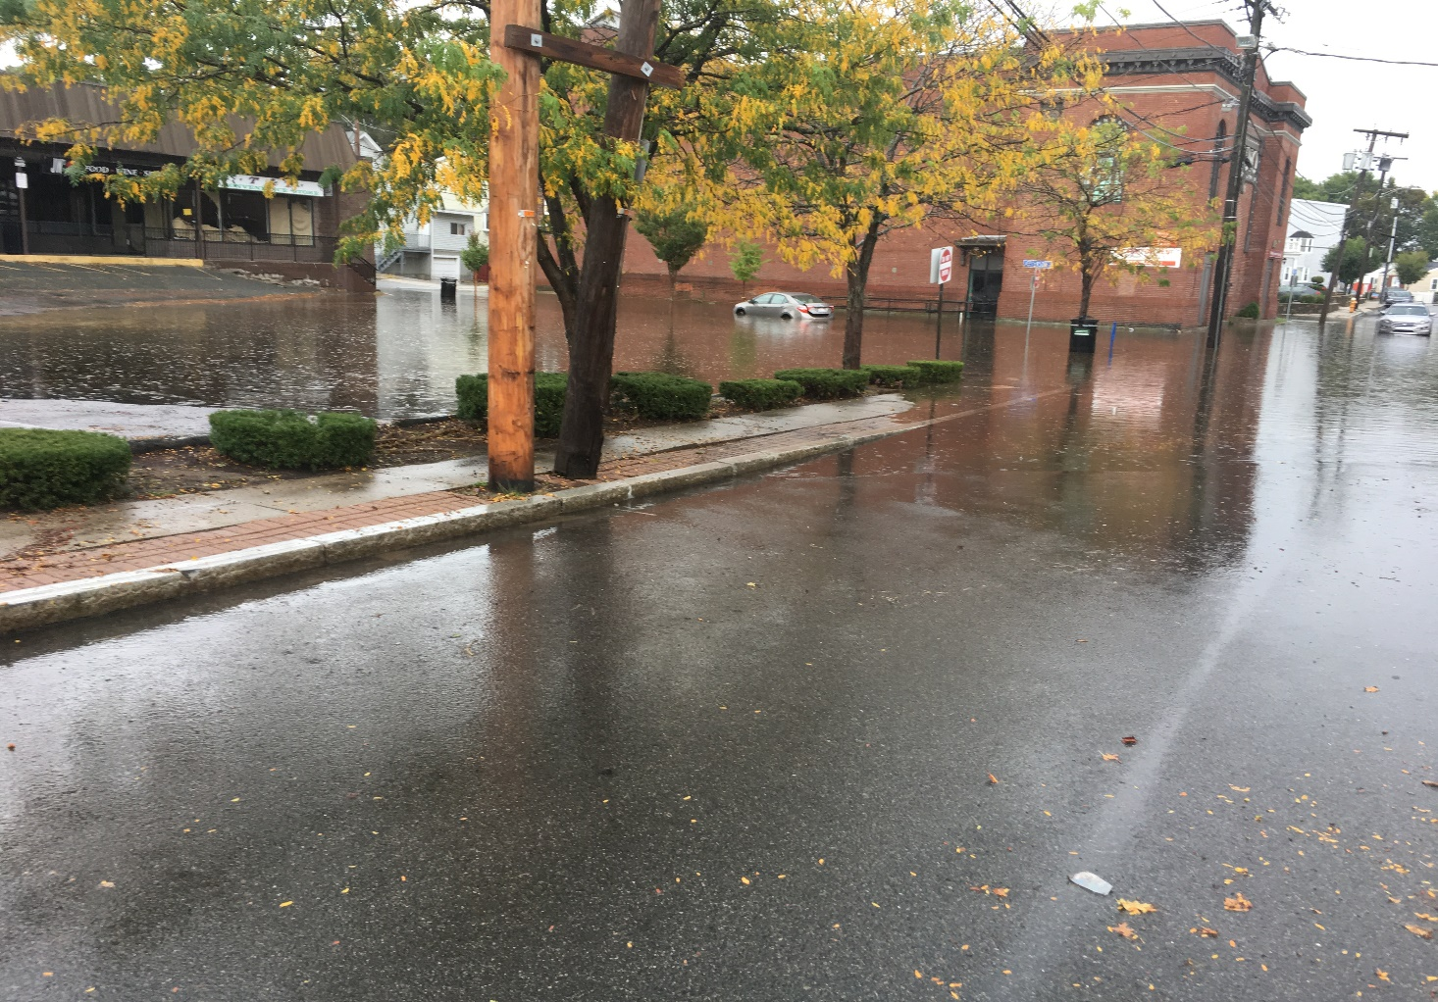
Winthrop, MA
Photo: Ingleside Park (2017)
Photo: Town Center (2017)
Photo: January 2018
Photo: Pico Avenue (March 2018)
Photo: Town Center (2017)
Photo: Pico Avenue (March 2018)
Photo: Ingleside Park
Photo: Banks at Wilshire (March 2018)
Photo: Ingleside Park (2017)
Photo: Morton at Banks (March 2018)
Photo: Ingleside Park (2017)
Photo: Ingleside Park (2017)

Slide 10

Municipal Vulnerability Preparedness (MVP) Grant Program
Communities who complete the MVP program become certified as an MVP community and are eligible for potential follow-up grant funding and other opportunities.

Slide 11
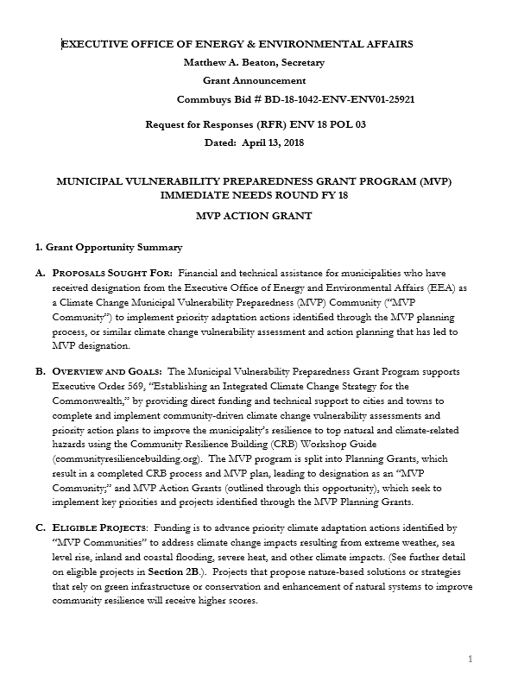
MVP Action Grant Program
Current MVP Action Grant Program open!
Applications are Due May 18, 2018
Winthrop is eligible because of MVP Planning participation
Can apply for up to $400,000
Projects that propose nature-based solutions or green infrastructure will receive higher scores
Eligible projects: detailed vulnerability and risk assessment, public education and communication, local bylaws, redesign and retrofit, nature based storm damage protection, nature based infrastructure, eco restoration

Slide 12
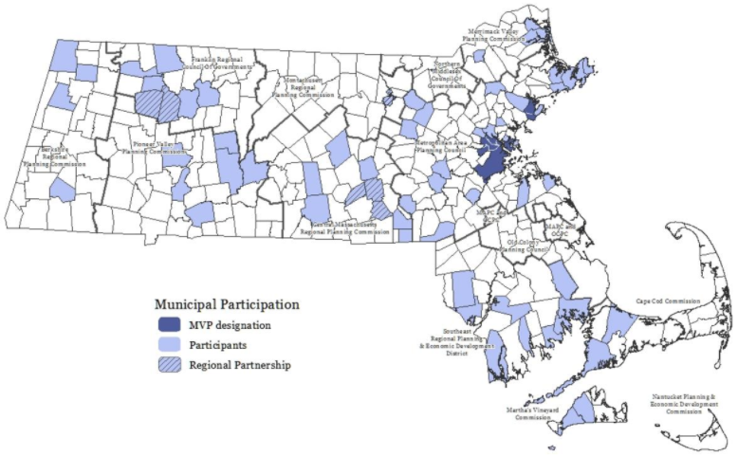
What Other Communities Are in the MVP Program?

Slide 13
Community Resiliency Building Workshop

Slide 14

Community Resiliency Building Workshop

Slide 15



Community Resiliency Building Workshop
CRB workshop held on April 6, 2018
Each Individual Identified Challenges & Goals
Background Information About Winthrop
Climate Change Presentation – MassAudubon
Characterized/Identified Natural Hazards
Identified Community Vulnerabilities & Strengths
Natural Infrastructure Solutions – Nature Conservancy
Identified & Prioritized Community Actions

Slide 16
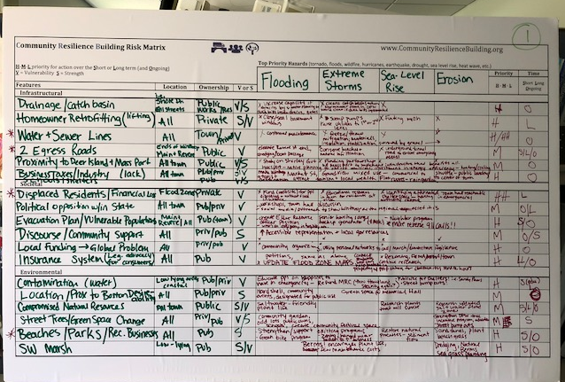
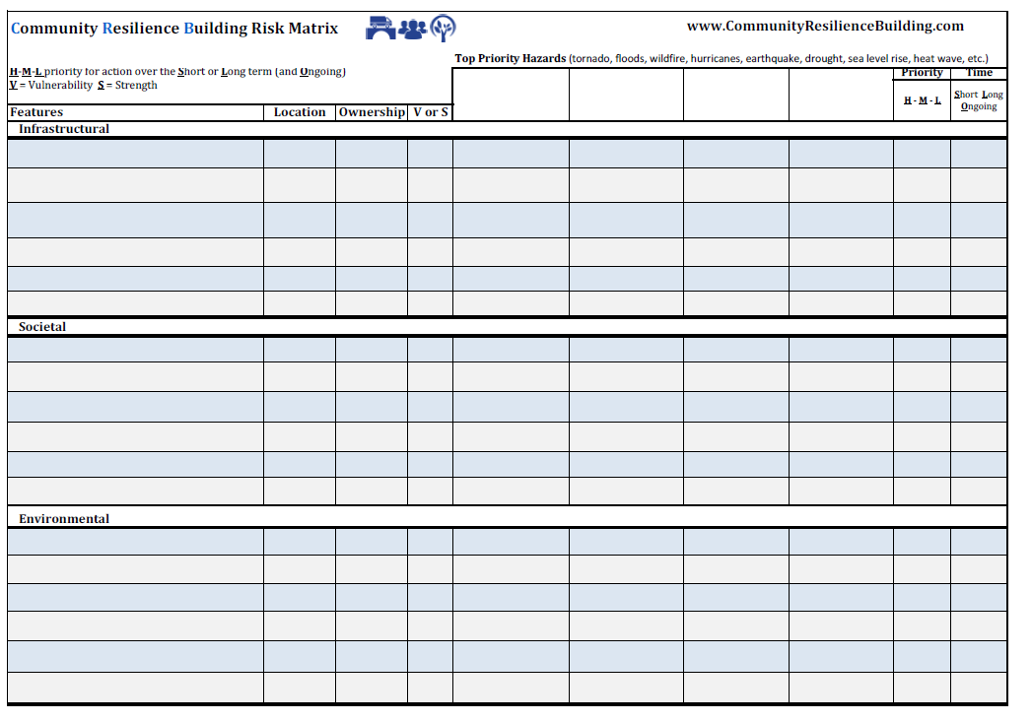
Community Resiliency Building Workshop - Matrix

Slide 17
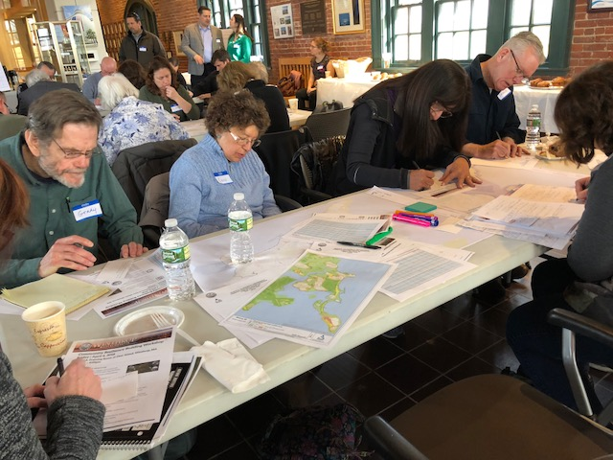
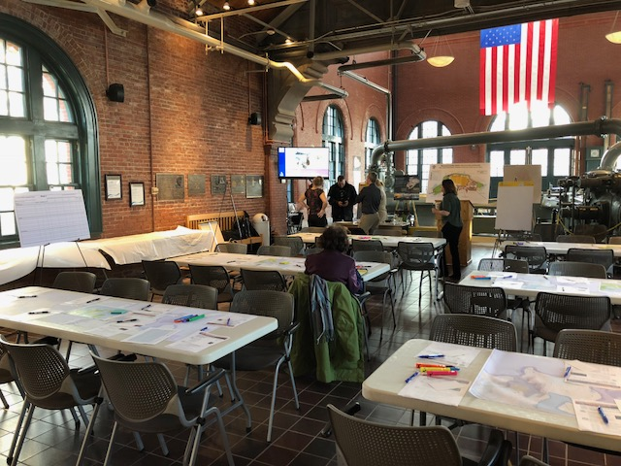
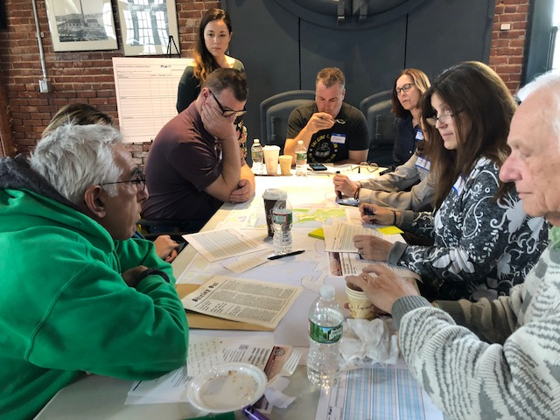
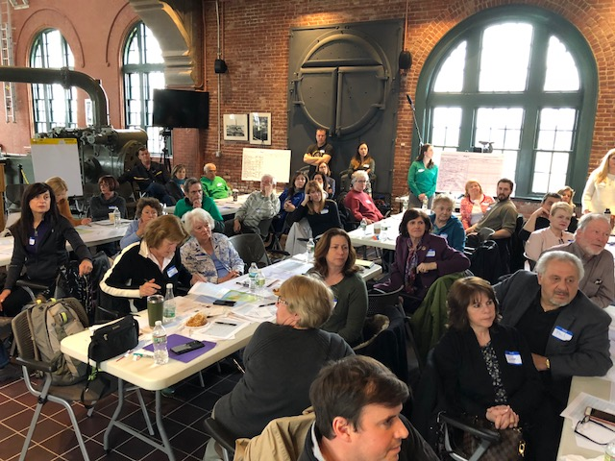
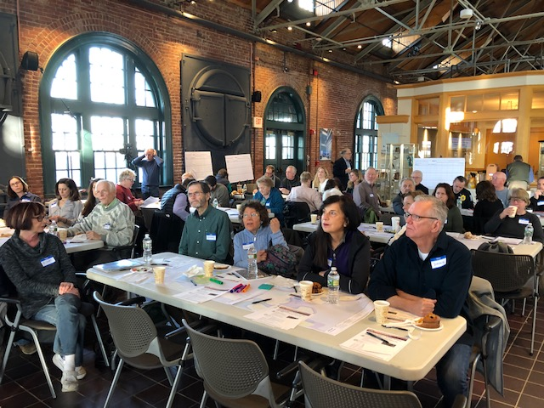
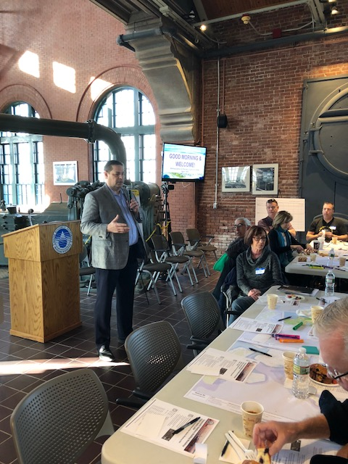
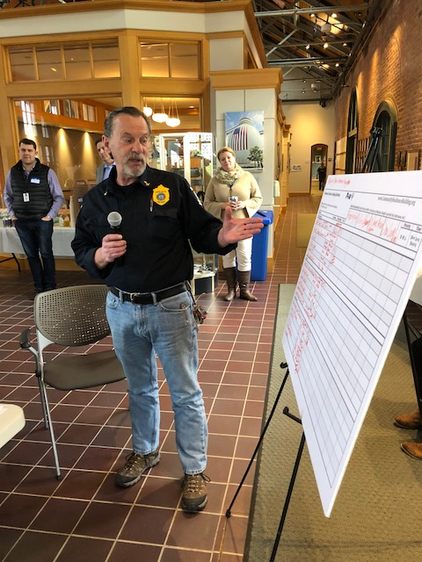
Community Resiliency Building Workshop

Slide 18
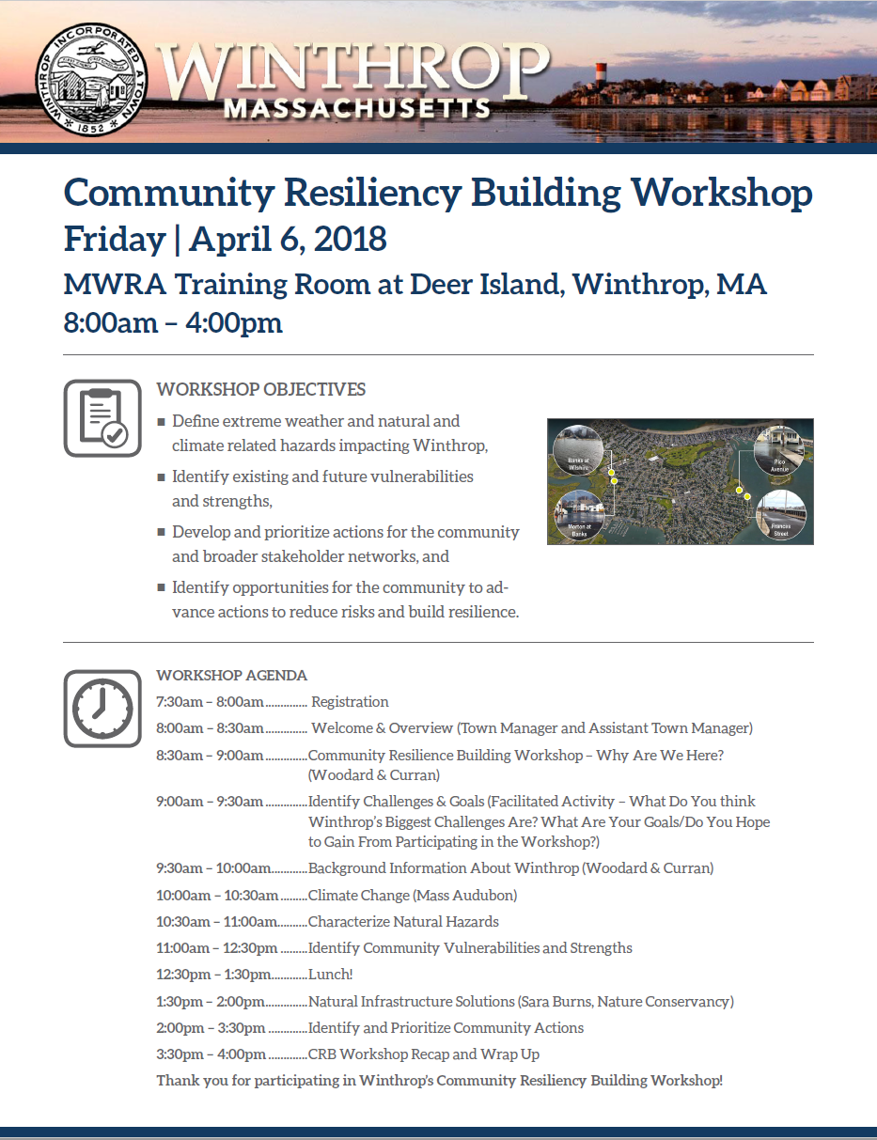
Community Resiliency Building Workshop
As part of the MVP program, participating communities MUST complete a Community Resiliency Building Workshop!
Upon completion of the workshop, a summary report will be submitted to EEA.
Winthrop will continue to use this guiding report to reinforce future planning and action item implementation.

Slide 19
Community Resiliency Building Workshop - Purpose
Address the need to build community resilience in a collaborative environment.
Foster a discussion that will help Winthrop adapt to extreme weather and natural hazard events.
Encourage continued proactive planning and actions focused on resiliency.
Consider all aspects of the community – residents, employees, students, infrastructure, the environment.

Slide 20
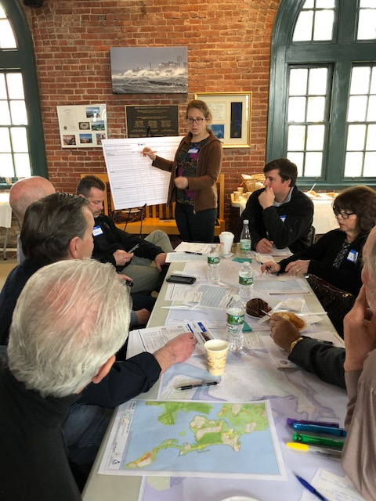
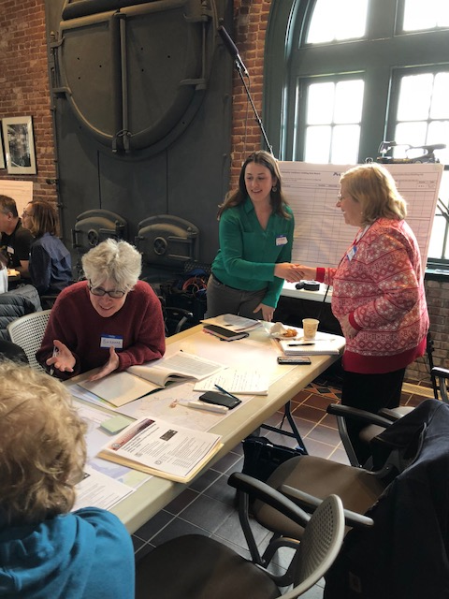
Community Resiliency Building Workshop - Intent
Foster collaboration amongst community stakeholders.
Advance education, planning and implementation of priority actions identified during the CRB process.

Slide 21
Community Resiliency Building Workshop - Objectives
The CRB was designed to help communities achieve the following objectives:
Define extreme weather and natural and climate related hazards
Identify existing and future vulnerabilities and strengths
Develop and prioritize actions for the community
Identify opportunities to take action to reduce risk and build resilience

Slide 22
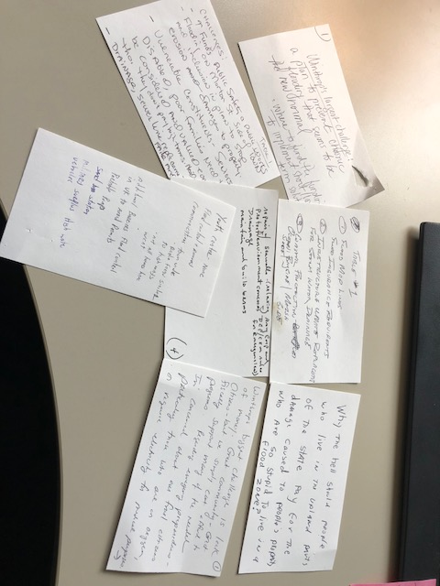
CRB Workshop – What We Heard From YOU!
Challenges
Need a plan for chronic flooding
Flood control and recovery
Where to find funding?
Flood Insurance Requirements
Infrastructure updates and drainage
Coastal protection
Vulnerable residents
Community engagement
Understanding nature based solutions
Evacuation plan
Isolation
Limited egress during emergencies
Challenges
Airport pollution
Power outages
Surrounded by ocean
Over development
Resiliency
Aging infrastructure
Erosion
Problem areas
Collaboration with MWRA and MassPort
Groundwater
Smart development
Energy resilience

Slide 23
CRB Workshop – What We Heard From YOU!
Goals
Develop a clear picture of how to be involved with action items
Information gathering
To be the voice of seniors in the community
Understand work accomplished to date
Identify target priorities
Communicate concerns
Discuss need for seawalls, berms
Discuss need for natural infrastructure
Better understand how Winthrop will be impacted by Climate Change
Goals
How can neighborhoods better prepare during emergencies
Learn more about emergency challenges
Heighten awareness
Contribute solutions
Take home ideas to implement
Meet other neighbors
Understand the action plan

Slide 24
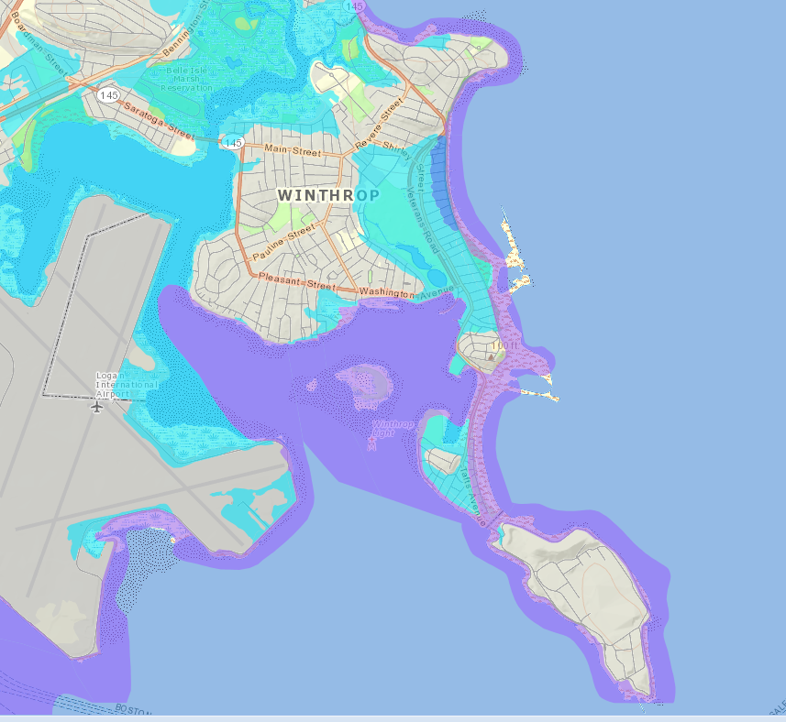
Community Resiliency Building Workshop - Outcomes
Top Natural Hazards Identified By Participants
Sea Level Rise
Flooding
Hurricanes/Wind/Extreme Storms
Wave Action/Storm Surge
Extreme Heat
Fire
Erosion
Increasing Precipitation
Isolation
FEMA Floodplain Map - Winthrop

Slide 25

CRB Workshop – Infrastructure Vulnerabilities
Drainage
Water & Sewer Lines
Only 2 Egress Roads
Proximity to MassPort/Deer Island
Lack of Businesses/Industry
Lights/lines – communication
Infrastructure (gas, power)
Residential homes
Water Tower
No concrete revetment on Deer Island
Lack of vegetation, dunes, trees
Roads
Bridges
Evacuation Routes
Public Safety Building
Culverts

Slide 26

CRB Workshop – Societal Vulnerabilities
Displaced Residents/Financial Loss
Political Opposition Within the State
Evacuation Plan
Vulnerable Populations
Isolation
Emergency Response
Financial Limitations/Crisis
Local Funding
Insurance System
Food Plan
Shelters
Yacht Clubs
Elderly Housing

Slide 27
CRB Workshop – Environmental Vulnerabilities
Contamination (Water)
Compromised Natural Resources
Street Trees/Green Space
Belle Isle Marsh
Ocean
Geographic Location
Coughlin Park
Place to Dispose Debris
Beach Erosion
Electrical Currents During Flooding
Natural Barriers
Funding
Harbor
Tree Cover
Wildlife

Slide 28

CRB Workshop – Infrastructure Strengths
Drainage System
Homeowner Retrofitting
Proximity to Deer Island/MassPort
Businesses/Industry
Schools/Shelters
Utility Power
Reverse 911
Green Infrastructure/LID
Sea Walls & Rip Rap
Utility Systems
Building Codes
Pervious Pavement
Water Tower

Slide 29
CRB Workshop – Societal Strengths
Discourse/Community Support
Legislative Representatives
MassPort
MWRA
Property Values
Con Com Working With Homeowners
People
Homeowner Incentives
Local Health Center
Schools/Shelters
Elderly Housing
Emergency Medical Center
Emergency Response Staff
Code Red

Slide 30
CRB Workshop – Environmental Strengths
Location/Proximity to Boston
Natural Resources
Street Trees/Green Space
Beaches, Parks, Recreation
Belle Isle Marsh
Coughlin Park
Tree Cover
Wildlife
Natural Barriers/Beaches
Parks/Golf Course
Wetland Protection
Harbor

Slide 31
Community Resiliency Building Workshop - Outcomes
Top 6 Recommendations to Improve Resiliency
Used Dot Exercise to refine the top priorities
Rank | Action
1 | Sewer & Drainage Infrastructure – Clean, maintain and upgrade (particularly in the Town Center and low lying areas).
2 | Maintain, Replace, Upgrade Seawalls
3 | Natural and Green Infrastructure Solutions, Low Impact Development (to support or enhance the functioning of seawalls and the shoreline as a barrier, for improved stormwater management)
4 | Develop or redevelop a new public safety building (police, fire, ambulance)
5 | Maintain and protect Belle Isle Marsh, Coughlin Park and beaches as assets to the community for both recreation and resiliency support
6 | Identify funding for projects to increase resilience (including further developing the tax base to increase revenue in the community)

Slide 32

Community Resiliency Building Workshop – Q & A
What questions do you have?
What comments do you have?
Can we clarify something for you?
What else do you want to make sure we capture through this CRB process?
Do you have feedback or a question you would like to submit via notecard?

Slide 33

Next Steps
Finalize CRB report and submit to EEA.
Upon review of CRB report by EEA, become a Certified MVP Community.
Seek out and apply for funding opportunities through grant programs for MVP communities.
Seek out and continue to apply for funding opportunities through other grant programs – CZM, PDM, FMA.
Continue to communicate with and engage Winthrop community in resiliency discussions and decisions.

Slide 34
Winthrop, MA
Community Resiliency Building Listening Session
May 8, 2018

