Slide 1
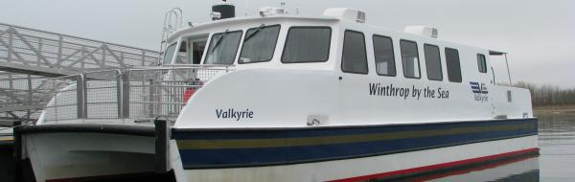
Winthrop Ferry Service
Prepared by Joseph Domelowicz, Tanji Cifuni, and Ashlyn Howard
Date: March 6, 2018

Slide 2
Why Winthrop Has a Ferry
Discussion of establishing a Winthrop ferry began in late 1990s
The primary justifications for the grant was to
protect the town’s small lobster/fishing business
create a commuter ferry to Boston
The Town began seeking grants to construct the pier, marina and terminal building between 2003-2005
Construction began with the pier and marina in 2009
The terminal building was built in 2011-12

Slide 3
Initial Funding
Building the Pier and Terminal
According to town records, the cost of construction was:
Pier/Waterside construction $2,757,815
Terminal/Landside construction $672,178
Total cost $3,429,993*
Sources of Construction Funds
PWED Grant $544,789
Seaport Advisory Council $1,168,676
Executive Office of Transportation $1,716,528**
Total grants and other $3,429,993
* Cost does not include repairing the grading of the Ferry Terminal HP ramps, funded by Town Council with an appropriation of $14,000
** EOT grants were pass through of Federal Transportation Administration funding

Slide 4
Initial Funding
In 2016, MassDOT provided $53,675 for enhancements to the ferry after the vessel was inspected by the town. The town contribute $10,735.
Total cost to build and improve the ferry: $1,073,660
Towns share: $234,985
Grants share: $838,675
The towns agreement to purchase the vessel with the state requires the boat be returned back to the state if we stop operating the ferry

Slide 5
Initial Funding, Cont.
Procurement of the Winthrop Ferry
In 2010, town received a Federal Ferry Boat grant of up to $950,000 which required a 25-percent local match.
2010-2014, the town and state worked on the process for procuring a boat
Pilot Ferry Service
Boston Harbor Cruises ran the pilot program
Started in 2010-2012
Funded with Federal Highway Administration
in the amount of $232,348 with no local match required
Construction of the Winthrop Ferry
In 2014, the town advertised for the construction of a new 75-px ferry boat
The specs of the ferry were designed by the state
Evan’s Boat Repair of Maryland was awarded the contract
The final cost of construction of the vessel was $981,252
$785,000 was paid through the FBD Grant and $196,250 was paid by the town.
The town also paid an additional $28,000 for electronics and navigation equipment for the vessel.
Notes:
Federal Grant Money of $950,000 and town match was $237,500

Slide 6
Service Provisions
Pilot Service by BHC
Began in 2010, funded by a federal grant through MassDOT with service provided by Boston Harbor Cruises
Operated half season in 2010, two five-month seasons in 2011 and 2012
Ridership
Year/Season | Months | # of Riders
2010 | August-October | 5,000 +
2011 | May-October | 11,165
2012 | May-October | 14,895
Notes:
Five trips a day from Winthrop to Rowe’s Wharf only

Slide 7
Service Provisions Cont.
Private Operator Service in 2013
The Town provided a license to operate a ferry service from the town
Proved to be unsuccessful due in part to:
the vessel type of vessel and schedule
the service also lacked marketing and no subsidy was provided
2014-2015: Two years of no service while the ferry was built
In December of 2015, Winthrop took possession of the ferry
Builder initially promised delivery of vessel in late July
March-April 2015, trained with BHC
Began service on April 1st with BHC assistance
Cut ties with BHC on April 30th and began operating on our own

Slide 8
Service Provisions Cont.
Since building the boat, Winthrop has spent $575,000 from the general fund on service operation
Town made a motion to appropriate $100,000 for three years to the operating budget. We are at the end of that third year and we are starting our third season of the ferry.
Fiscal Year | Amount from General Fund
FY15 | $50,000
FY16 | $250,000
FY17 | $175,000
FY18 | $100,000
Notes:
FY15 – Spent $285 of the $50,000 and the balance of $49,715 was transferred over to FY16. The Ferry was not delivered until Dec 2015 and never in service
FY16 – Spent $142,503.21 of the $250,000 Vessel. This covered a lot of one time start up costs and training of all the crew. Ferry was in service from April-June 30 ’16 and brought in $19,306.15 via our online reservation system. The only trips we provided were from Winthrop to Rowes Wharf during this time period.
FY17 – Amount from General Fund $175,000 and spent $325,497.22. Ran ferry from Winthrop to Boston in July and then added Quincy in August through November 30th of 2017. Started service up again in early May and only serviced Winthrop to Seaport and Winthrop to Moakley through June 30th. Quincy’s dock was in disrepair due to storm damage and we could not provide Spring season. Rowes Wharf wanted a contract with us and it took months to work it out so we did not stop there until end of June. Brought in net sales of $101,455.98
FY18 – Amount from General Fund $100,000. We received a $75,000 from Mass DOT and we will receive $150,000 from Mass DEP and have been brought in $66,258.26 in ticket sales servicing Winthrop to Boston to Seaport and Quincy. We anticipate bringing in $22,000 plus this Spring.

Slide 9
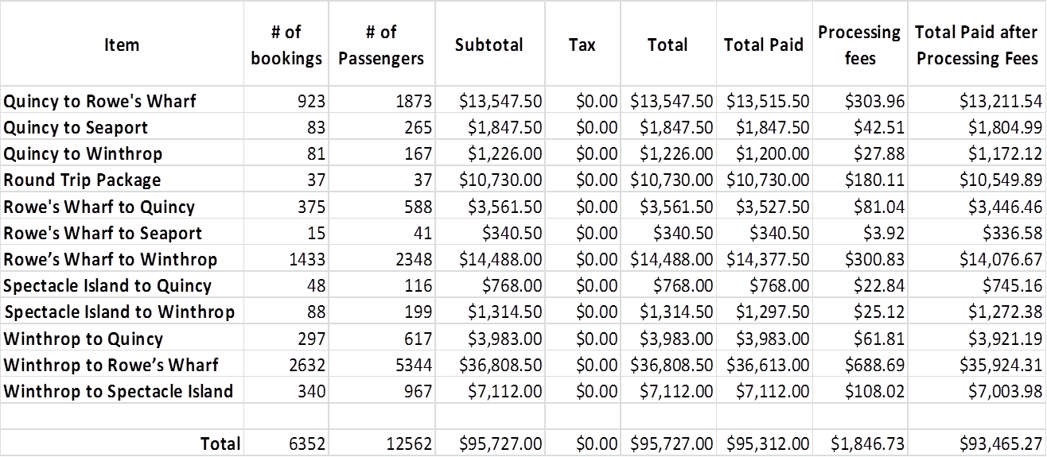
2016 Ferry Season Mid-April through November 30, 2016

Slide 10
2017 Ferry Season May 1 through November 30, 2017
Item | # of Bookings | # of Passengers | Total | Total Paid | Processing Fees | Total Paid after Processing Fees
Afternoon Boston Harbor Cruise | 17 | 31 | $775.00 | $775.00 | $19.84 | $755.16
Boston Harbor Islans Narrative Cruise | 38 | 67 | $1,675.00 | $1,125.00 | $28.76 | $1,096.24
Boston Moakley Courthouse to Winthrop | 101 | 149 | $673.50 | $656.50 | $13.62 | $642.88
Parade of the Tall Ships | 31 | 70 | $5,250.00 | $4,875.00 | $101.60 | $4,773.40
*Quincy to Rowe's Wharf | 719 | 1745 | $11,343.50 | $11,300.50 | $245.61 | $11,054.89
*Quincy to Seaport | 133 | 405 | $2,791.00 | $2,791.00 | $49.32 | $2,741.68
*Quincy to Winthrop | 272 | 435 | $2,656.00 | $2,643.00 | $54.91 | $2,588.09
Retail | 8 | 9 | $143.94 | $143.94 | $2.69 | $141.25
Round Trip Package | 42 | 42 | $12,180.00 | $12,180.00 | $238.21 | $11,941.79
Rowe's Wharf to Quincy | 636 | 1111 | $5,919.50 | $5,898.00 | $134.02 | $5,763.98
Rowe's Wharf to Seaport | 260 | 381 | $1,696.50 | $1,686.00 | $40.77 | $1,645.23
Rowe's Wharf to Winthrop | 307 | 523 | $2,891.00 | $2,831.50 | $49.68 | $2,781.82
Seaport to Boston Moakley Courthouse | 15 | 19 | $76.50 | $76.50 | $2.03 | $74.47
Seaport to Rowe's Wharf | 157 | 313 | $1,775.50 | $1,754.00 | $29.32 | $1,724.68
Seaport to Winthrop | 527 | 695 | $2,326.00 | $2,298.00 | $64.49 | $2,233.51
Tall Ships in Boston Harbor | 89 | 280 | $7,000.00 | $6,750.00 | $154.72 | $6,595.28
Twilight Cruise | 85 | 185 | $4,625.00 | $4,625.00 | $109.85 | $4,515.15
Winthrop to Boston Moakley Courthouse | 74 | 184 | $1,062.00 | $1,028.00 | $19.11 | $1,008.89
Winthrop to Quincy | 128 | 196 | $1,046.50 | $1,046.50 | $22.06 | $1,024.44
Winthrop to Rowe's Wharf | 629 | 1389 | $8,447.00 | $8,374.50 | $158.74 | $8,215.76
Winthrop to Seaport | 1803 | 3670 | $22,501.50 | $21,847.50 | $383.61 | $21,463.89
Charters |  |  |  |  |  | $3,500.00
Totals | 6071 | 11899 | $96,854.94 | $94,705.44 | $1,922.96 | $96,282.48
* Quincy didn't come on board until June 24th due to their dock breaking

Slide 11
Budget for Current Fiscal Year
FY18 total expense/revenue projected at $419,000
Total Subsidy: $325,000
$100,000 Town Subsidy (General Fund)
$75,000 MassDOT to service Quincy
$150,000 MassDEP for servicing Seaport to Boston*
The town projected $155,000 in ticket revenue for FY18
Actual Ticket sales from July 1st - November 30th 2017 = $66,258.26.
$325,000 total subsidy + $66,258.26 net ticket sales = $391,258.26
Leaving a balance of $27,741.74 to cover operating costs for FY18
This is feasible with ticket sales from mid-April through June 30th
*This MassDEP subsidy has not been received yet.

Slide 12
Tax Payer Contribution
There are 5,485 tax payers in Winthrop
The yearly contribution from the General Fund to cover the operating costs of the ferry: $100,000
Each tax payer would pay $18.23 per year to have access to a ferry service from Winthrop to the Financial District, Seaport, Quincy or for recreational purposes.
A ferry service enhances our house values.
Driving in and out of Winthrop is not getting any better and this option can help alleviate some of the traffic if the commuting rates are decreased to a more affordable rate

Slide 13
Things to Consider
Based on level of ridership in the last two years and opportunity to provide non-commuter cruises, we are projecting $130,000 amount of revenue for 7/1/2018 - 6/30/2019
The town, through the Chief, has begun conversation with the state about the ferry regarding regional efforts and has asked for $135,000 subsidy from MBTA to service Quincy
The town is anticipating $150,000 funding from DEP this spring and asked for an annual subsidy
The town has not provided any significant marketing of the ferry
There are an estimated 1,800 Winthrop residents who work in the financial district, who either drive or take public transportation to work when they could utilize the ferry

Slide 14
Things to Consider
There is no easy way to get from Winthrop to the Seaport
The ferry has the potential to solve this
GE and Amazon are bringing jobs to the Seaport; the ferry would make Winthrop an attractive place to live for those employees
Our Traffic leaving town in the mornings continues to be a problem. If we reduce the commuting rates to $5.50 and provide free parking then it could attract many more commuters from Revere and Winthrop to take the Ferry vs. driving.
Barriers to Sustainable Service
Ferry is more expensive to take than other public transportation because it is not currently subsidized by the state
Many people do not know about the ferry, if the town is to continue operating, it must do more marketing
Current service is not a year-round transportation option

