Slide 1
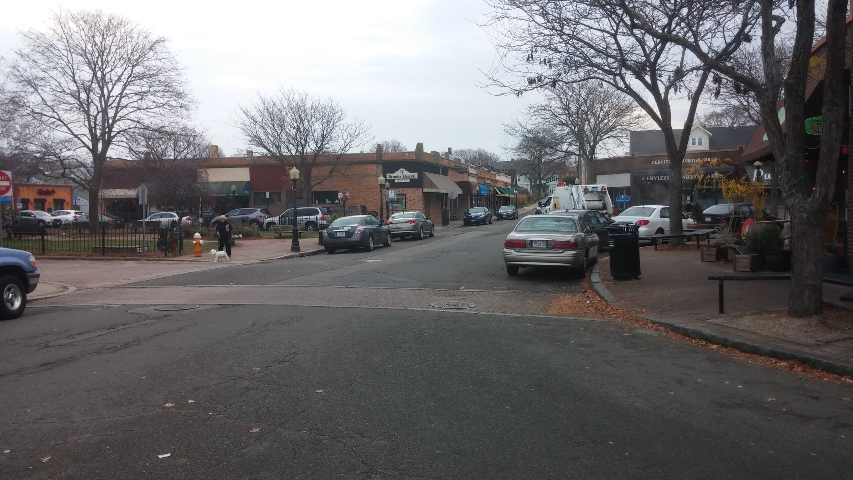
Centre Business District and Old Middle School Master Plan
Update for the Economic Development Citizens’
Advisory Council

Slide 2
Goal for the Master Plan
Community
com·mu·ni·ty
noun
1.
a group of people living in the same place or having a particular characteristic in common.
2.
a feeling of fellowship with others, as a result of sharing common attitudes, interests, and goals.

Slide 3
Goal for the Master Plan
Develop a set of common goals and objectives for the CBD and old Middle School
Determine community’s interests and needs
Build consensus in the community
Identify what is acceptable in terms of scope and massing
Outline strategies for implementing the plan over a period of time
Make recommendations to Town Council and Economic Development subcommittee about implementation

Slide 4
Items for EDCAC to consider
Need for public uses of the public land
Parking needs for present and future users of parcels in the locus
Appropriate uses of the public land and spaces
Appropriate zoning of the public land and spaces
Management/leasing of the public spaces
Appropriate mix of public and private uses?
What is/are the highest and best uses of the land/space?
Needs and goals of redevelopment of the Centre Business District

Slide 5
Items for EDCAC to consider
Costs/benefits of private uses versus public uses
Potential zoning and ordinance amendments/relief to move the plan forward
Infrastructure needs for redevelopment of the CBD and public improvements
Engineering analysis?
Strategies for attracting outside investment/ development partners
Accommodations for existing businesses
Relocation options for businesses impacted by development
Private assistance from outside development (linkage)

Slide 6
Next Steps
Establish EDCAC Officers
Agree to meeting schedule
Schedule public visioning sessions and workshops with project partners
MAPC
MassDevelopment
Form + Place

Slide 7
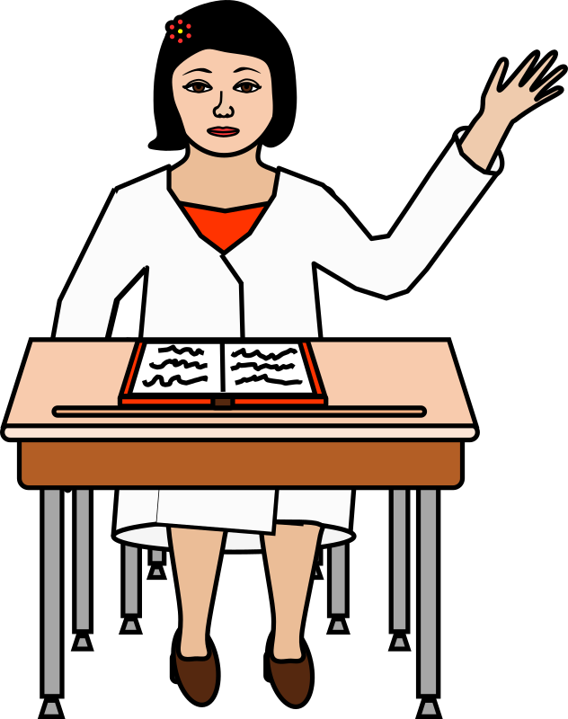
Questions ?

